Slide 1

Moving Hearts and Minds Upward
Adventist Education
Notes:
This PowerPoint presentation was used in a sermon at Forest Grove, Oregon on September 22, 2012.
Title: Moving Hearts and Minds Upward
Key Text: Proverbs 22:6
Opening Hymn: “All Things Bright and Beautiful” #93
Closing Hymn: “I’d Rather Have Jesus” #327
Feel free to edit and use this as needed. Because I teach science & biology grades 6-10, you will notice this presentation is science oriented. I was asked to include some history of Adventist Education in my sermon. The historical photographs came from the online Andrews photo archive. There may be an image or two obtained during a Google image search. Other graphics used came from the NAD Education website and Cognitive Genesis. All the color photographs at the end of the presentation were taken by me of students at my school. If you have questions you may contact me. Phil Kahler: philk@tvja.org
Greenleaf, F. (2005). Timeline for seventh-day adventist education. Journal of Adventist Education, Retrieved from http://circle.adventist.org/files/jae/en/jae200567051005.pdf
Information posted at the Circle website was very helpful.
http://circle.adventist.org/services/info/?topic=adventist_ed

Slide 2
Adventist Education
“Train up a child in the way he should go, And when he is old he will not depart from it.”
Proverbs 22:6 (NKJV)

Slide 3

Adventist Education

Slide 4
Adventist Education
Every Adventist teacher is committed to moving the hearts and minds of the children entrusted to them upward.
Above all else their desire for their students is that they will develop a personal relationship with Jesus.

Slide 5
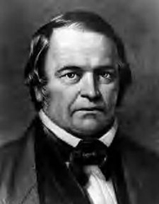
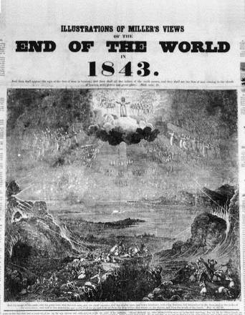
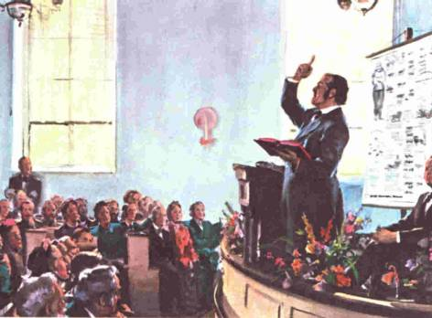
History of Adventist Education
1844 – Great Disappointment
William Miller

Slide 6
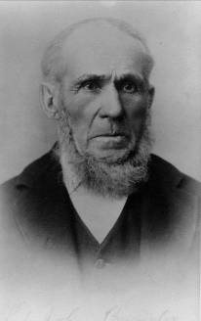

In 1853 Martha Byington became the First Seventh-day Adventist Teacher at Buck’s Bridge, NY.
History of Adventist Education
Martha’s father, John Byington, later became the first General Conference President.
Notes:
In 1853, at the age of 19, Martha donated her services as the First Seventh-day Adventist teacher. Martha's first class in Bucks Bridge, New York had an enrollment of 17 students. John Byington, Martha’s father later became the first General Conference President.

Slide 7
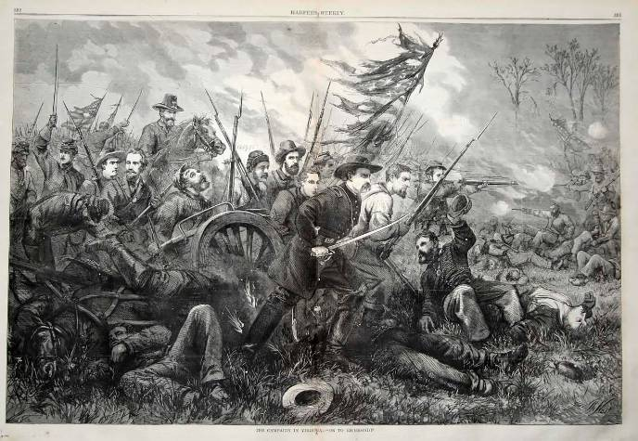
History of Adventist Education
1861 – 1865 – Civil War

Slide 8
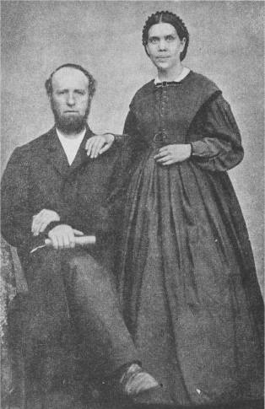
History of Adventist Education
1872
  Ellen G. White publishes her essay, “Proper Education”.
  First school sponsored by the Seventh-day Adventist Church opens in Battle Creek, Michigan.

Slide 9
History of Adventist Education
“The early education of youth shapes their character in this life, and in their religious life. Solomon says, “Train up a child in the way he should go, and when he is old he will not depart from it.” This language is positive. The training which Solomon enjoins is to direct, educate, and develop. In order for parents and teachers to do this work, they must themselves understand “the way the child should go.”
(Proper Education, September 1, 1872)

Slide 10
History of Adventist Education
“This embraces more than merely having a knowledge of books. It takes in everything that is good, virtuous, righteous, and holy. It comprehends the practice of temperance, godliness, brotherly kindness, and love to God, and to each other. In order to attain this object, the physical, mental, moral, and religious education of children must have attention.”
(Proper Education, September 1, 1872)

Slide 11
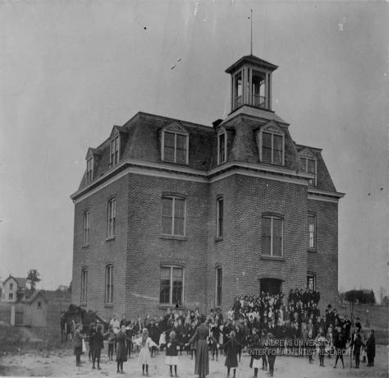
History of Adventist Education
1874
  Battle Creek College, the first Adventist college opens.

Slide 12
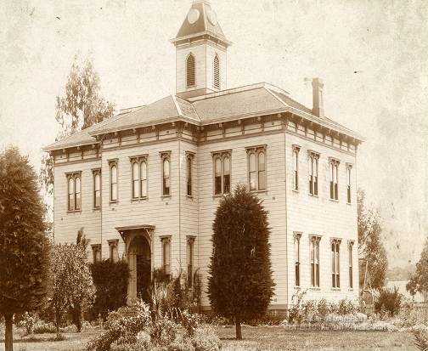
History of Adventist Education
1882
  Healdsburg College in California is the second Adventist college to open. The name was later changed to Pacific Union College and the school was moved to Angwin.

Slide 13
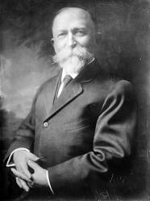
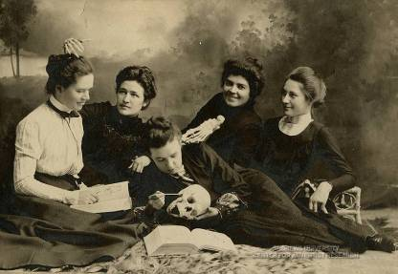
History of Adventist Education
1883
  School of nursing opens at Battle Creek Sanitarium under Dr. John Harvey Kellogg.
1895
  Battle Creek Sanitarium establishes the first Adventist School of medicine, American Medical Missionary College, with John Harvey Kellogg as president.

Slide 14
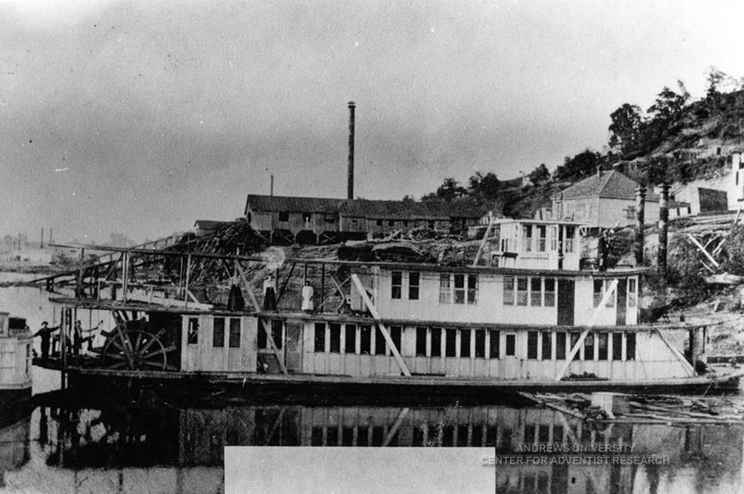
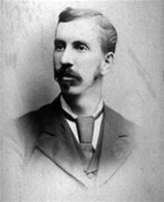
History of Adventist Education
The Morning Star, on which James E. White (son of James & Ellen White) established the first Adventist school for African-Americans in 1895.

Slide 15
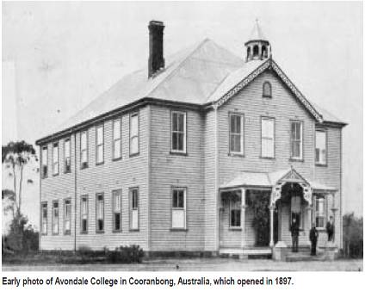
History of Adventist Education
1897
  Avondale College in Australia opens.
1900
  220 Adventist elementary schools in North America.

Slide 16
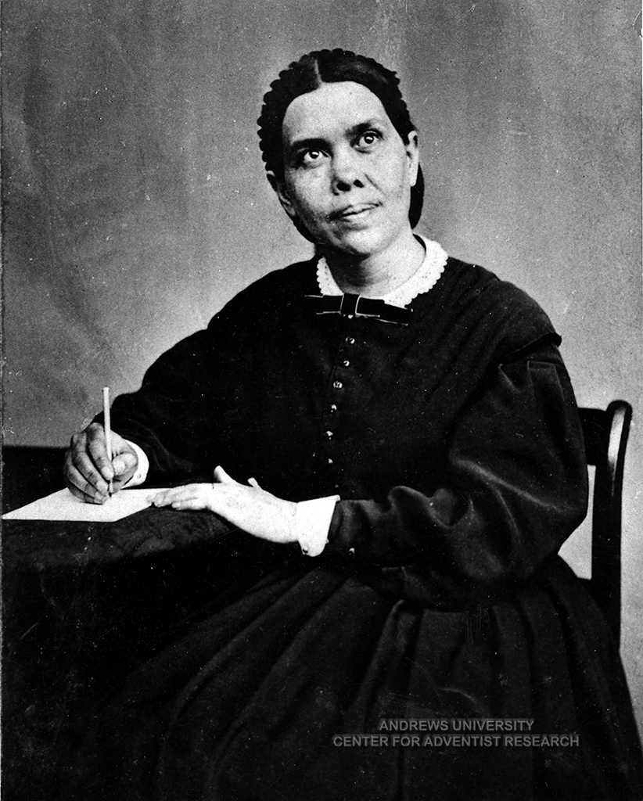

History of Adventist Education
1903
  Ellen White publishes Education, the leading Adventist book on education. It becomes a top source for college classes on principles of Christian education.

Slide 17
History of Adventist Education
“True education means more than the pursual of a certain course of study. It means more than a preparation for the life that now is. It has to do with the whole being, and with the whole period of existence possible to man. It is the harmonious development of the physical, the mental, and the spiritual powers. It prepares the student for the joy of service in this world and for the higher joy of wider service in the world to come.”
(Education p.13)

Slide 18
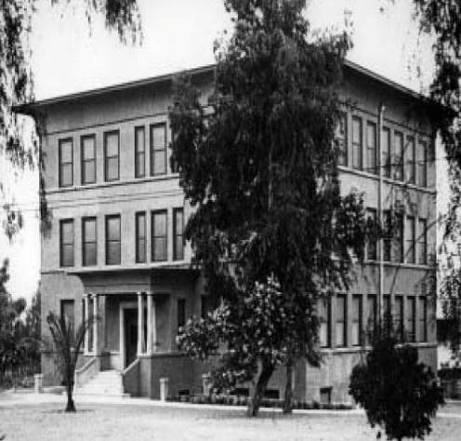
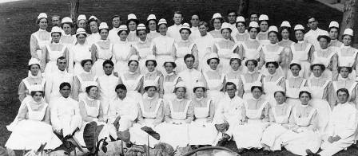
History of Adventist Education
1905
  The Southern California Conference buys a resort hotel that will become Loma Linda University and the following year, opens a school of nursing.

Slide 19
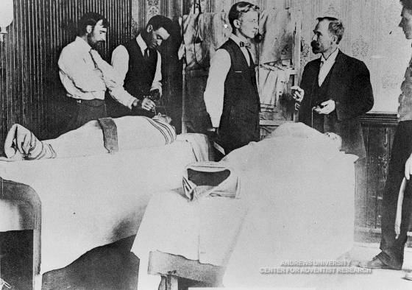
History of Adventist Education
1909
  The College of Medical Evangelists begins to operate schools of medicine and dentistry at Loma Linda.

Slide 20
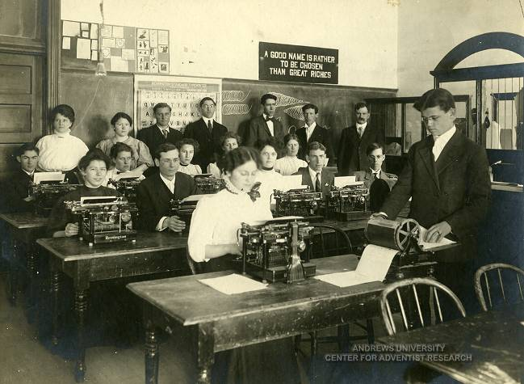
History of Adventist Education
Walla Walla College - 1909

Slide 21
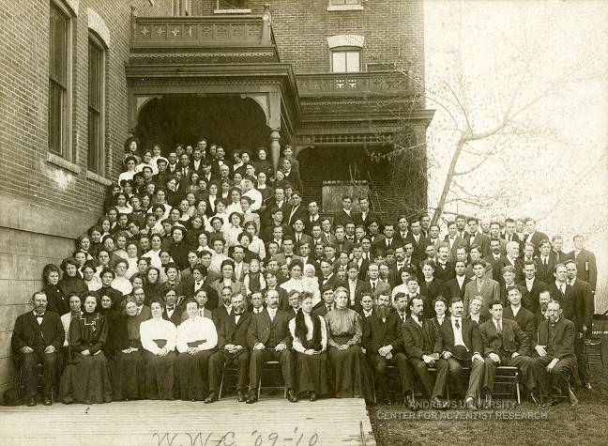
History of Adventist Education
Walla Walla College - 1909

Slide 22
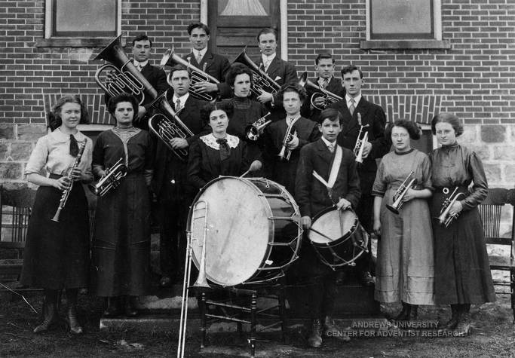
History of Adventist Education
Canada - 1910

Slide 23
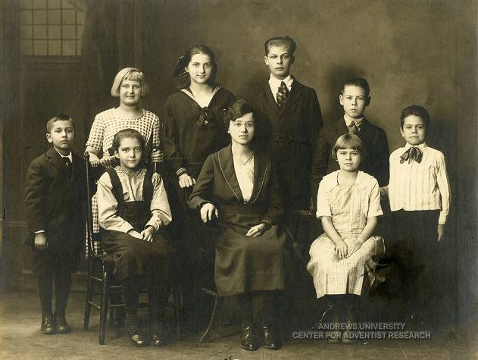
History of Adventist Education
Lebanon, Pennsylvania -1922

Slide 24
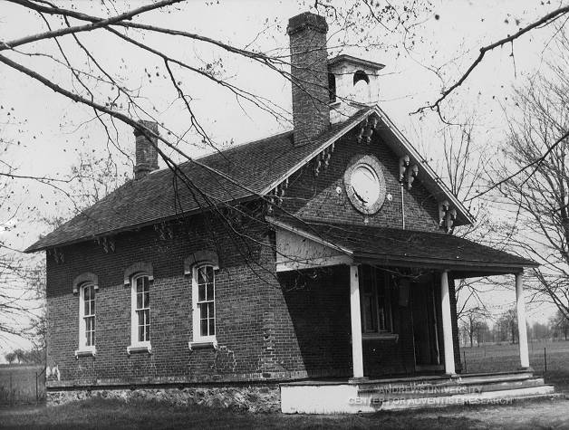
History of Adventist Education
Hillsdale, Michigan -1940’s

Slide 25
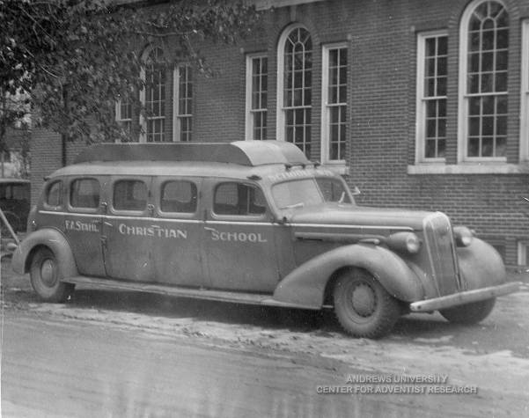
History of Adventist Education
Muskegon, Michigan – 1940’s

Slide 26
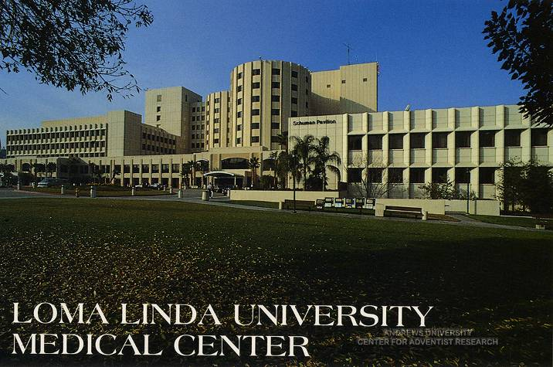
History of Adventist Education

Slide 27
History of Adventist Education
Today in the North American Division:
  879 Schools
  8,582 Teachers
  80,541 Students
Worldwide:
  6,709 Schools
Adventist Education is the second largest denominational educational system in the world, second only to Catholic schools.

Slide 28
The Cognitive Genesis Study
“Amid all the buzz on education reform, the Seventh Day Adventist school system might seem an unexpected place to look for models in improving student achievement. But by educating mind, body, and spirit, Adventist schools outperform the national average across all demographics.”
For real education reform, take a cue from the Adventists
By Elissa Kido, Ed.D., professor of education at La Sierra University
Posted on www.csmonitor.com on November 15, 2010.

Slide 29

The Cognitive Genesis Study

Slide 30
The Cognitive Genesis Study
“Even we were surprised by the results. Our four-year, independently financed study showed that students at Adventist schools outperformed their peers at the national average in every subject area.”
“One of our most dramatic findings is that students who transferred to Adventist schools saw a marked improvement in academic achievement. The more years a student attended an Adventist school, the more his or her performance improved.”

Slide 31
The Cognitive Genesis Study
“So how do we account for the Adventist advantage? We believe it lies in the holistic approach these schools take – a commitment to educating mind, body, and spirit. Unlike public schools, Adventist schools across the country have a standard curriculum. It includes the traditional "three R's" along with emphasis on spiritual and physical development. There's a coherence and a connectedness between Adventist schools that doesn't often exist in other systems.”

Slide 32
The Cognitive Genesis Study
“Some of the biggest predictors for student achievement, according to statistical models we developed, include whether students have a positive spiritual outlook, have a healthy relationship with their parents, and take care of their own health. These are all attitudes that can be cultivated, and they point to the importance of a holistic approach to education.”
For real education reform, take a cue from the Adventists
By Elissa Kido, Ed.D., professor of education at La Sierra University
Posted on www.csmonitor.com on November 15, 2010.

Slide 33
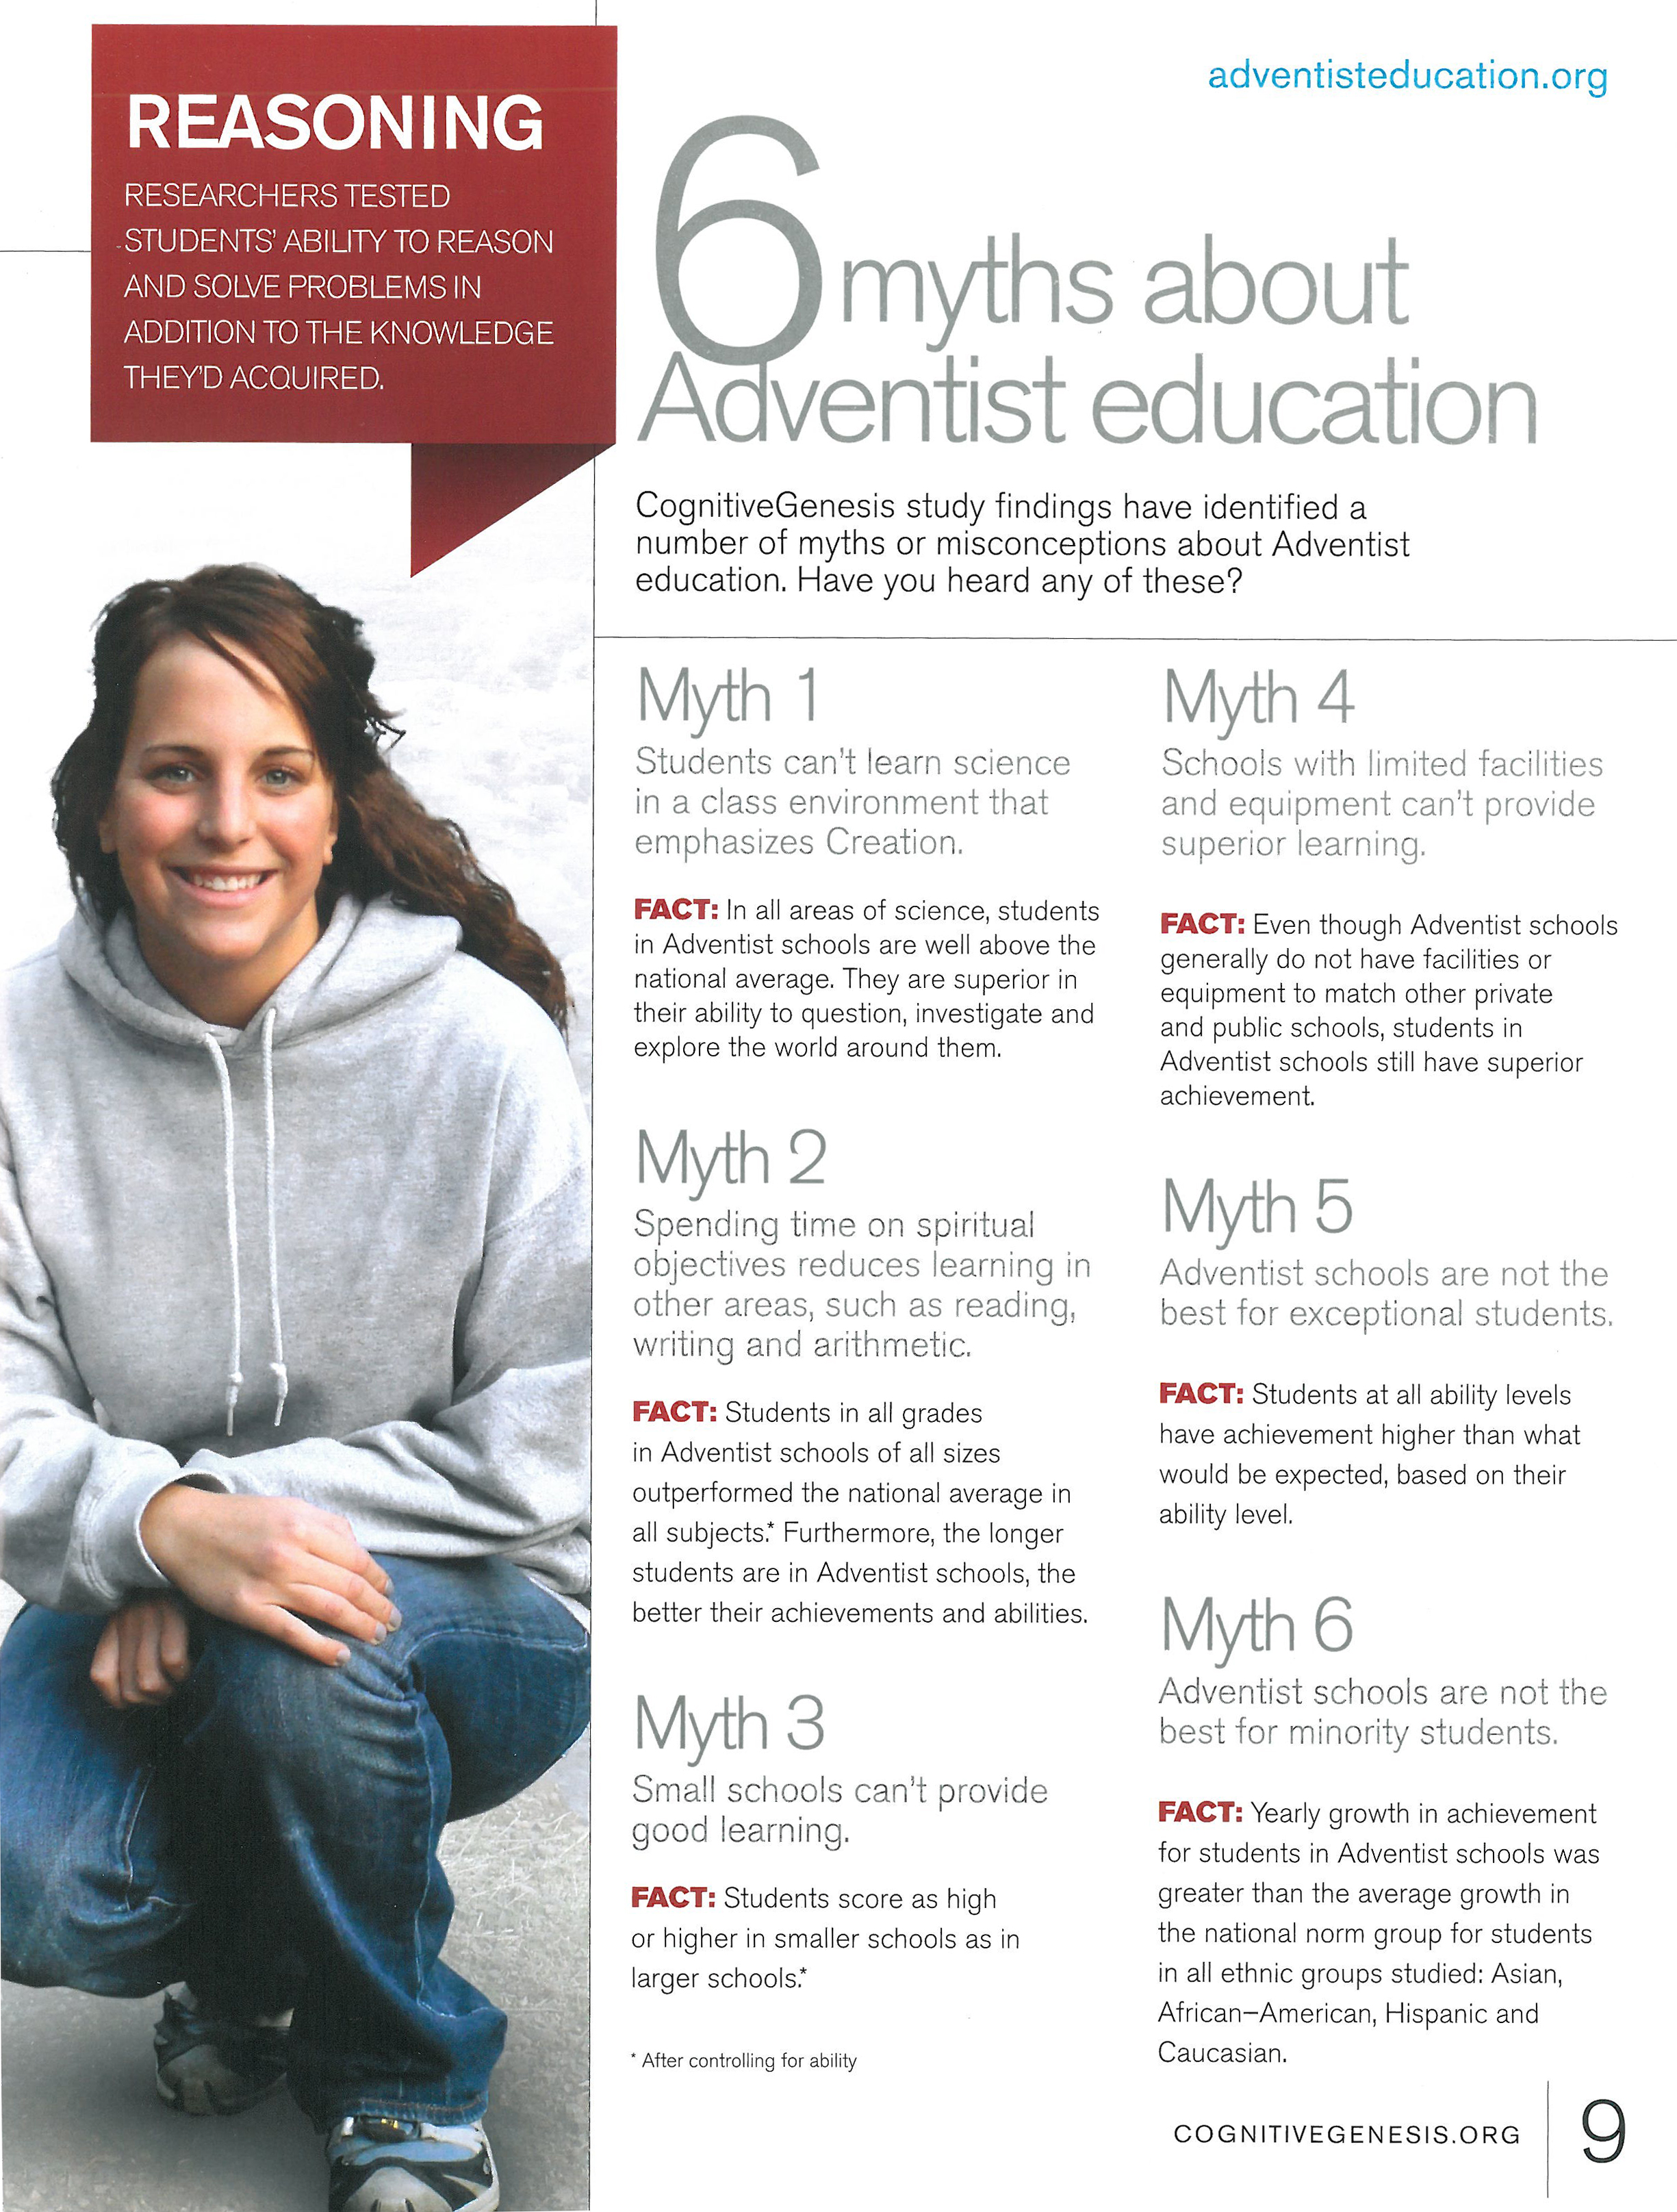

Slide 36
Why the 9th & 10th grade program is so essential at Tualatin Valley Academy
Why your children, grandchildren, and neighbor’s children belong at Tualatin Valley Academy
And

Slide 37
Creation Vs. Evolution
Over 50% of the students who leave TVA after 8th grade go to public high school.
100% of these students will complete a biology course that emphasizes evolution as a unifying theme.
During these biology classes it is very likely that evolution will come up on a daily basis.

Slide 38

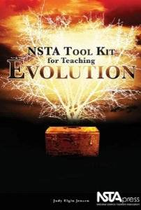


Creation Vs. Evolution

Slide 39

Creation Vs. Evolution
Bill Nye the Intolerant Science Guy: "Your Kids" Need to "Believe in" Evolution
As anyone who follows the Internet debate over evolution probably already knows, Bill Nye the Science Guy recently posted a viral YouTube video attacking those who he says "deny evolution."
Nye's most recent comments are noteworthy because he articulates the intolerant position of many evolutionists towards skeptics.
Nye says, "When you have a portion of the population that doesn't believe in it [evolution], that holds everybody back." He says that those who "deny evolution" have a worldview that "becomes crazy."
The Center for Science & Culture
http://www.evolutionnews.org/2012/08/bill_nye_the_in_1063641.html

Slide 40
Creation Vs. Evolution
Bill Nye the Intolerant Science Guy: "Your Kids" Need to "Believe in" Evolution
Nye then defines scientific literacy as demanding acceptance of evolution, and would remove from parents the freedom to teach their kids about problems with evolution:
“And I say to the grownups, if you want to deny evolution and live in your world that's completely inconsistent with everything we observe in the universe, that's fine. But don't make your kids do it because we need them. We need scientifically literate voters and taxpayers for the future. We need engineers that can build stuff, solve problems.”
The Center for Science & Culture
http://www.evolutionnews.org/2012/08/bill_nye_the_in_1063641.html

Slide 41
Creation Vs. Evolution
Where do you want your kids to learn about evolution?
Where do you want your kids to learn about God?

Slide 42
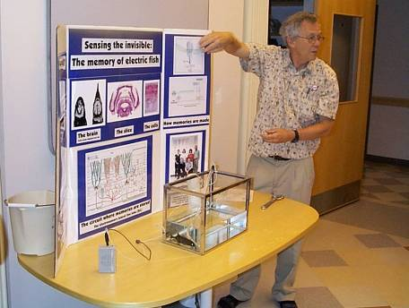
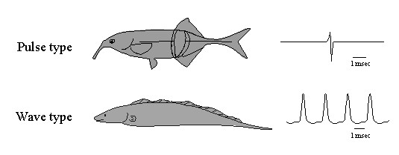
Creation Vs. Evolution
In November 2004 our 9/10 Biology class visited Dr. Curtis Bell in his research laboratory at OHSU in Beaverton. Here we learned about weakly electric fish.
“Phil, how can you teach science in a Christian school?”

Slide 43
Creation Vs. Evolution
“It is the work of true education…, to train the youth to be thinkers, and not mere reflectors of other men’s thought.” (Education p.17)

Slide 44

Creation Vs. Evolution
“By faith we understand that the entire universe was formed at God’s command, that what we now see did not come from anything that can be seen.”
Hebrews 11:3 (NLT)

Slide 45


Slide 46

Creation Vs. Evolution
“But ask the animals, and they will teach you, or the birds of the sky, and they will tell you; or speak to the earth, and it will teach you, or let the fish in the sea inform you. Which of all these does not know that the hand of the Lord has done this? In his hand is the life of every creature and the breath of all mankind.”
Job 12:7-10 (NIV)

Slide 47
Six Reasons for Adventist Education
It introduces students to the Bible as a framework for thinking and evaluating.
It introduces young people to Jesus Christ as Lord and Savior.
Adventist schooling at its best leads a person to a lifelong dedication of service to others.
Adventist schooling helps students to view every topic from the philosophic perspective of Scripture. (values)
One of the major contributions of Adventist schools is to bring young people together in sufficient numbers so that they can make lifelong friends and meet spouses who share their vision of what is important in life.
The influence of godly teachers and other adult role models is also very important. Lessons are best learned when students hear the same message at school, home, and church.
Knight, G. R. (2005). Why have adventist education?. Journal of adventist education.

Slide 48

Adventist Education

Slide 49
Because a picture is worth a thousand words…
Notes:
This is where you need to include pictures from your own school program. The pictures that follow are examples from my school.

Slide 50
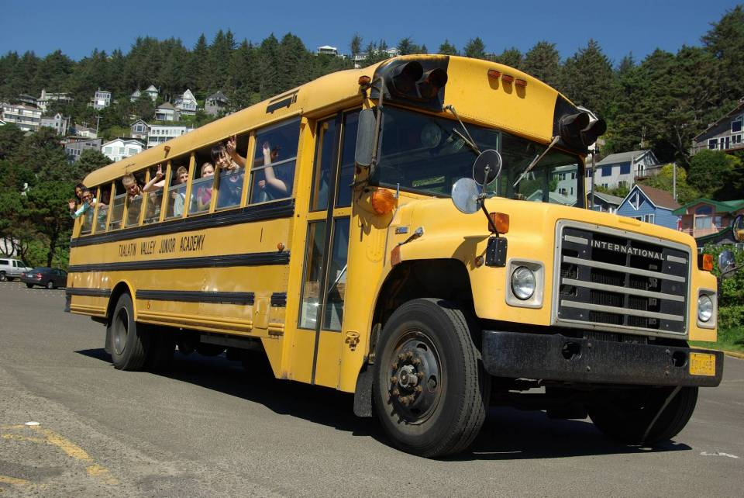
Tualatin Valley Academy has all the Extras
Exciting Learning Adventures
(Field Trips)

Slide 51
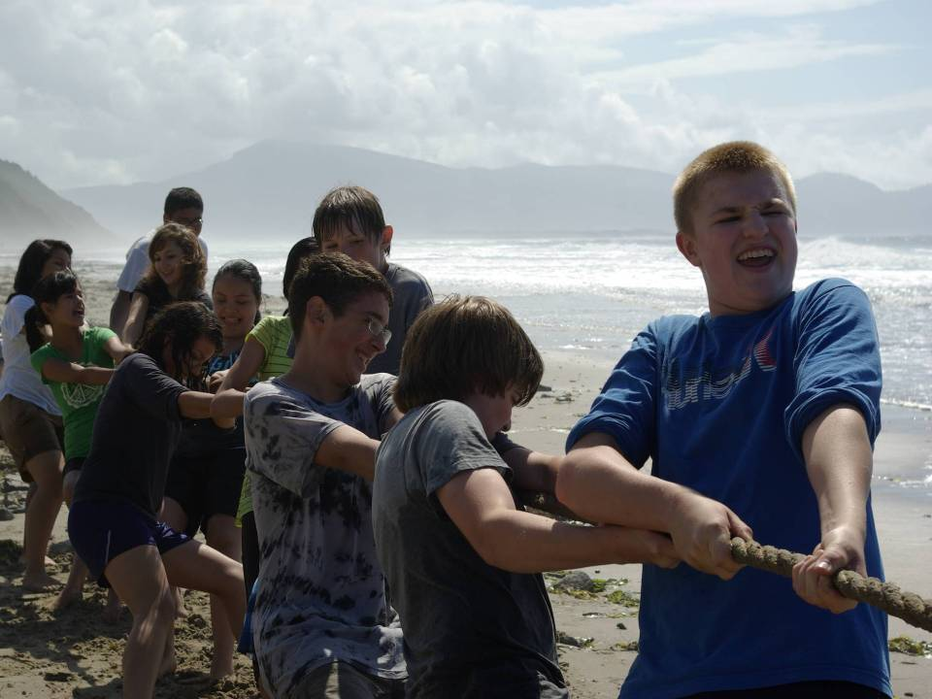
Tualatin Valley Academy has all the Extras
Jr. / High Beach Day

Slide 52
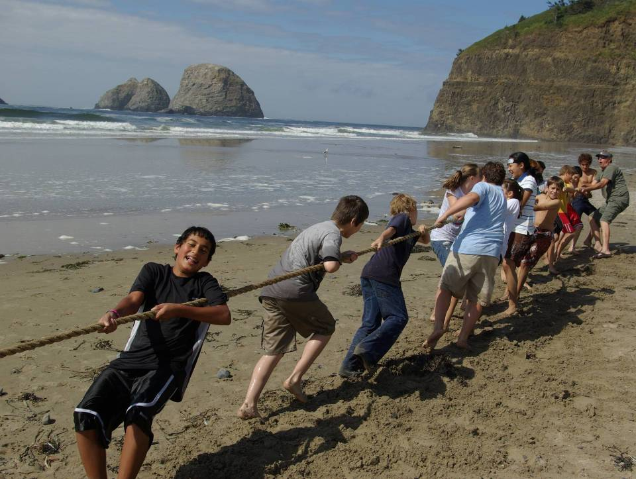
Tualatin Valley Academy has all the Extras
Jr. / High Beach Day

Slide 53
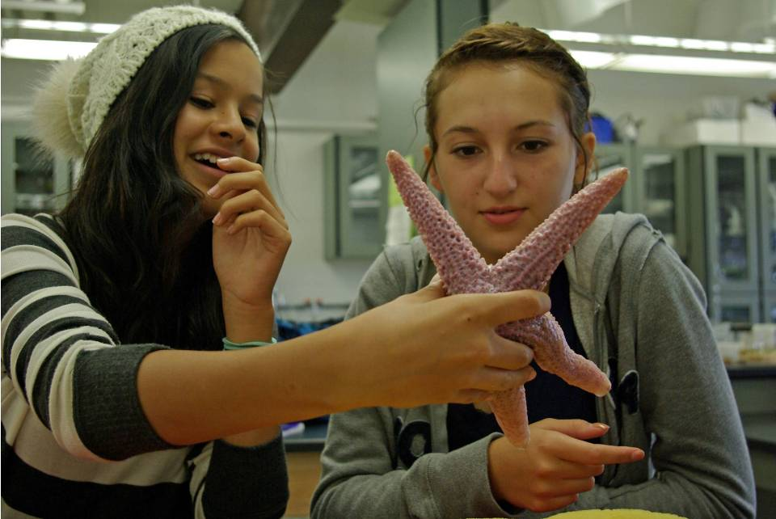
Tualatin Valley Academy has all the Extras
Marine Biology Trip – Lab at Hatfield Marine Science Center

Slide 54
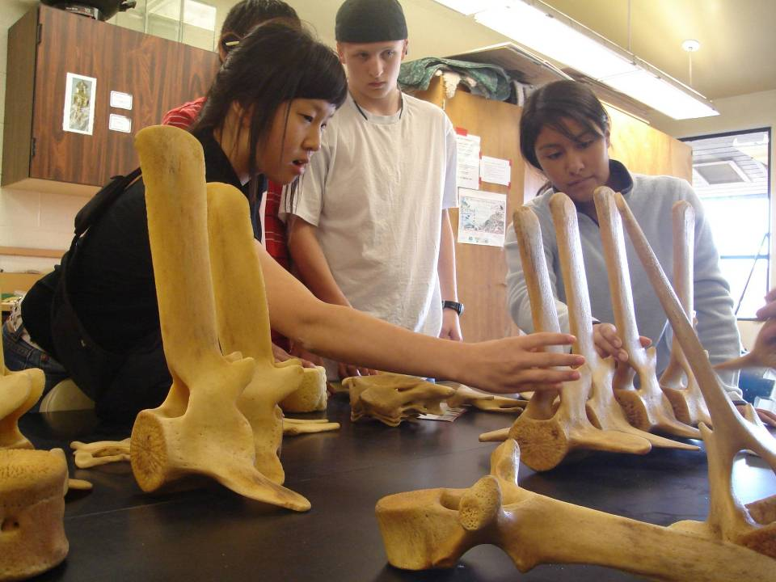
Tualatin Valley Academy has all the Extras
Marine Biology Trip – Lab at Hatfield Marine Science Center

Slide 55
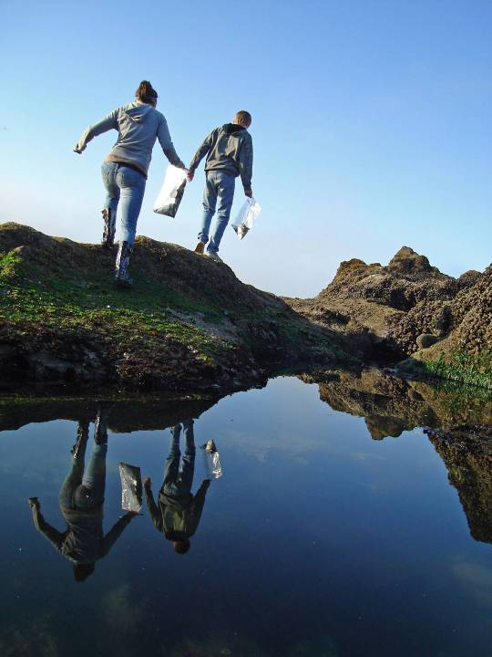
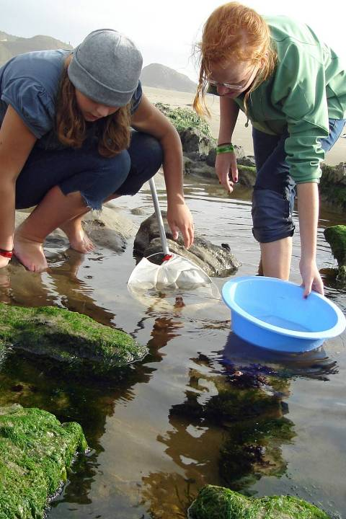
Tualatin Valley Academy has all the Extras
Marine Biology Trip – Tide Pools at Seal Rock

Slide 56
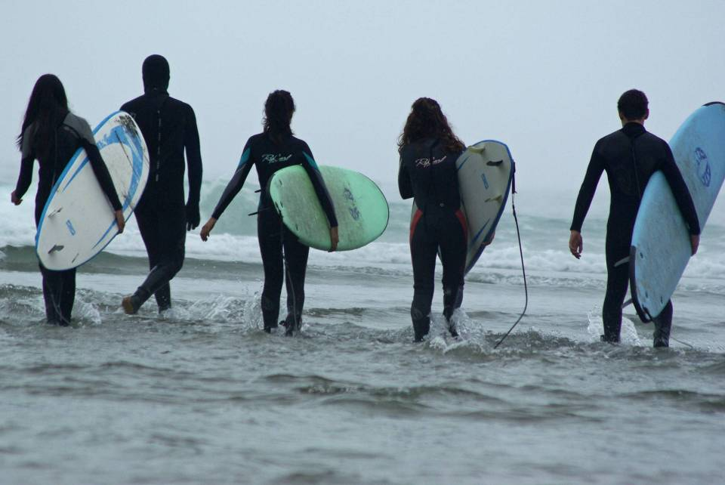
Tualatin Valley Academy has all the Extras
Marine Biology Trip – Surfing at Otter Rock

Slide 57

Tualatin Valley Academy has all the Extras
Marine Biology Trip – Surfing at Otter Rock

Slide 58
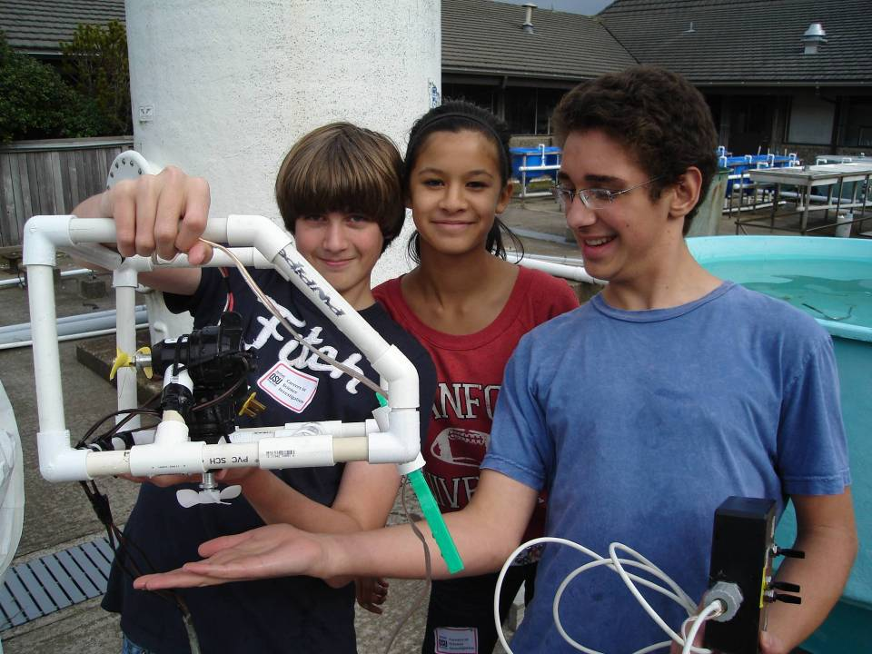
Tualatin Valley Academy has all the Extras
Career Day at HMSC – ROV Lab

Slide 59
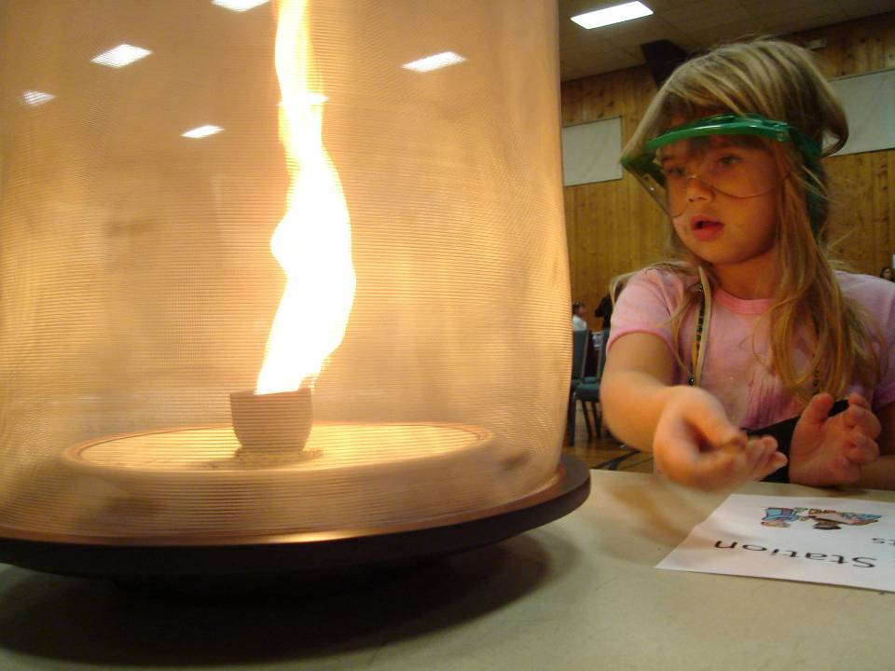
Tualatin Valley Academy has all the Extras
Science Fair

Slide 60
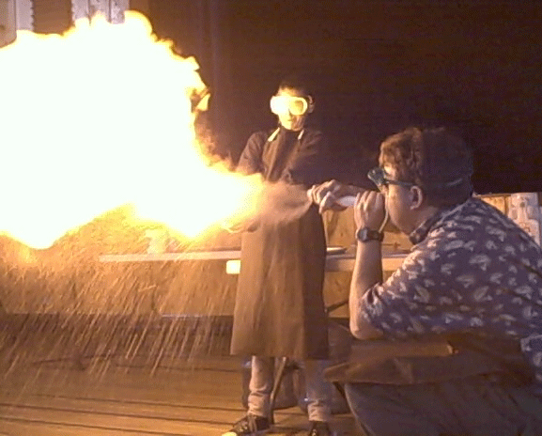
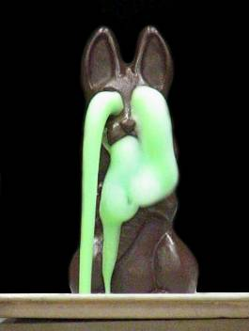
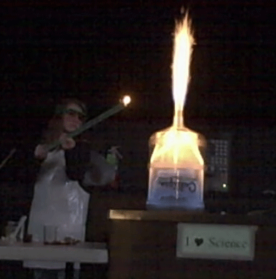
Tualatin Valley Academy has all the Extras
Science Fair is a Blast!!!

Slide 61
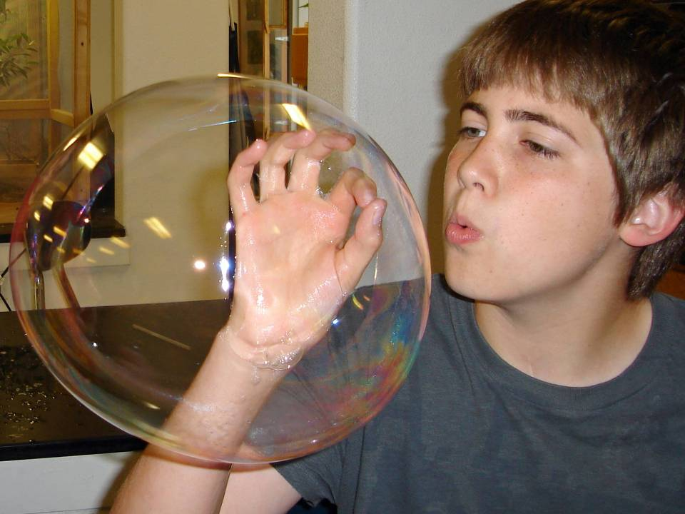
Tualatin Valley Academy has all the Extras
Fun Lab Activities

Slide 62
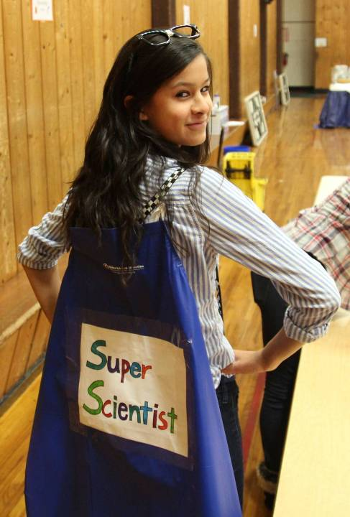
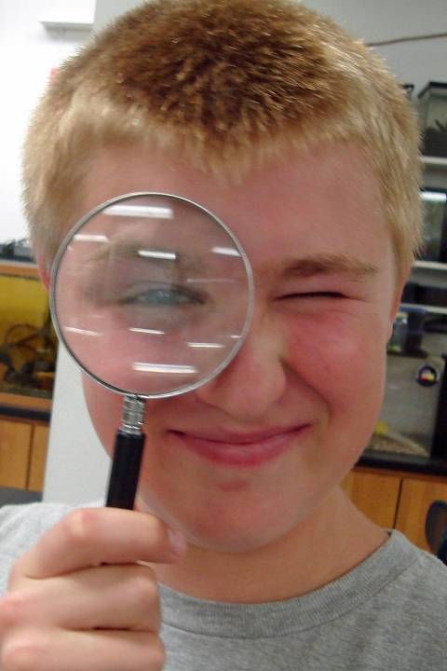
Tualatin Valley Academy has all the Extras
Enthusiastic Learners!

Slide 63
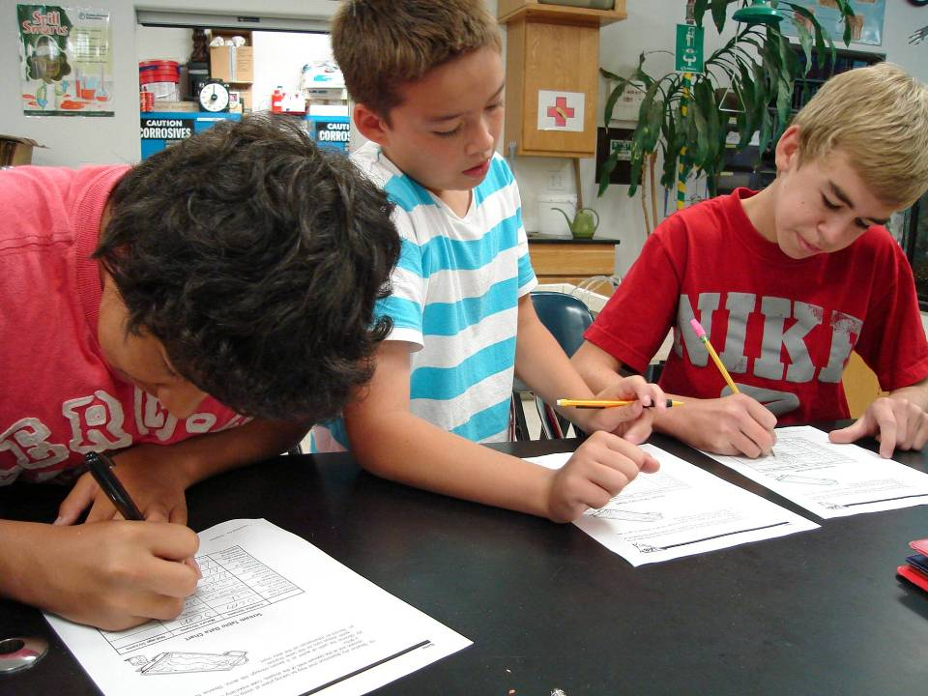
Tualatin Valley Academy has all the Extras
Enthusiastic Learners!

Slide 64
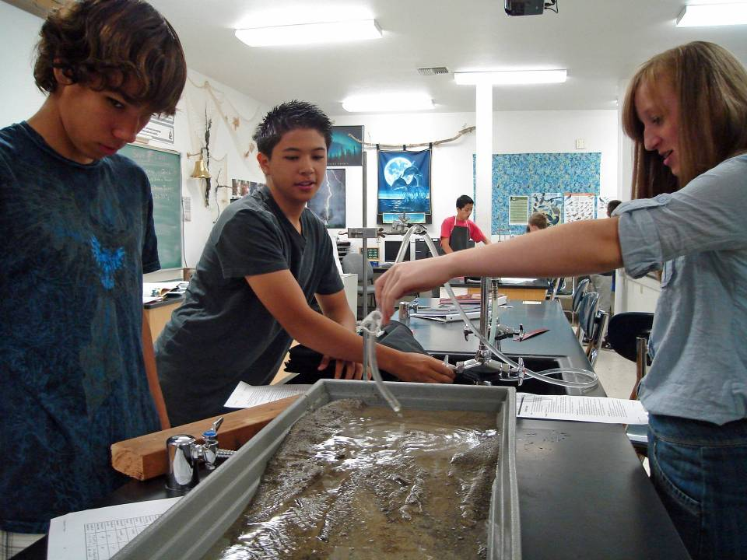
Tualatin Valley Academy has all the Extras
7th & 8th Grade Stream Table Lab

Slide 65

Tualatin Valley Academy has all the Extras
6th Grade Chemistry Lab

Slide 66
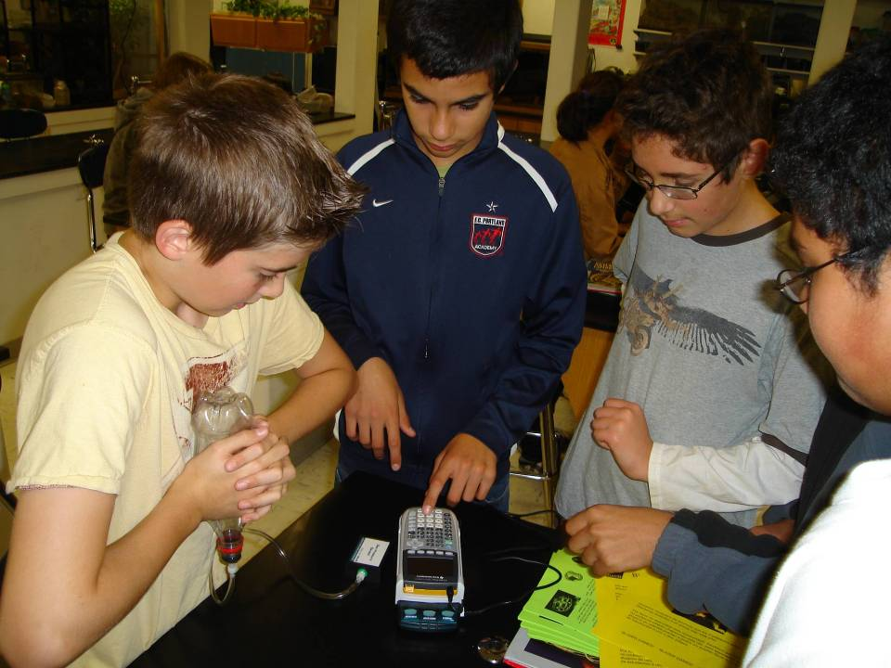
Tualatin Valley Academy has all the Extras
Science Labs with Modern Equipment

Slide 67
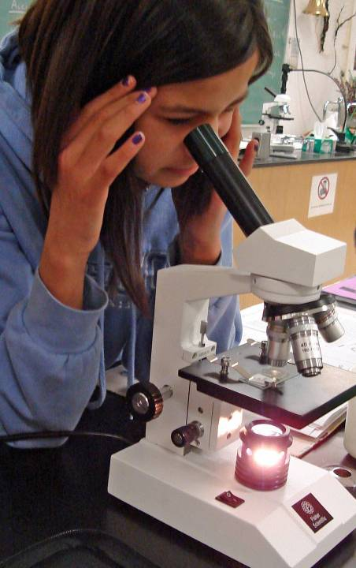
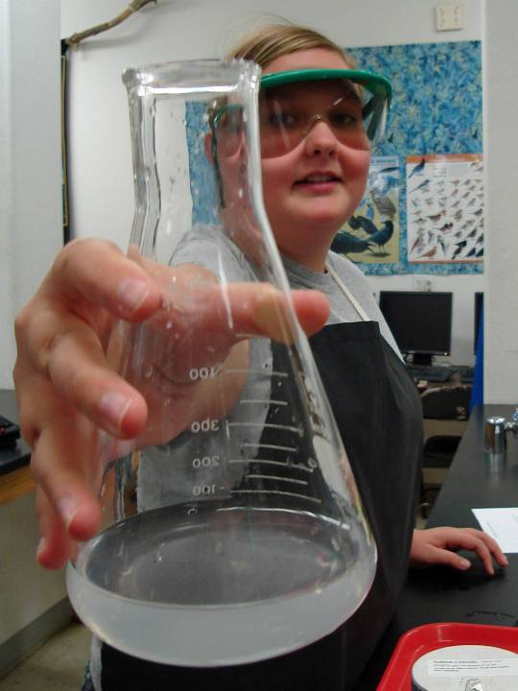
Tualatin Valley Academy has all the Extras
Science Labs with Modern Equipment

Slide 68
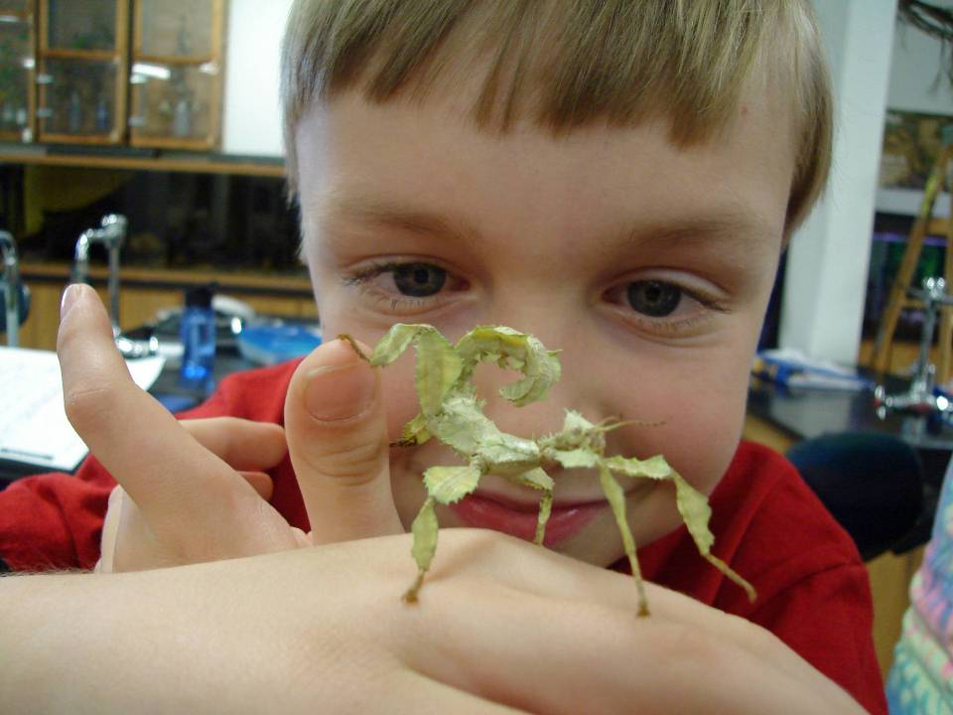
Tualatin Valley Academy has all the Extras
6th Grade Insect Lab

Slide 69


Slide 70

Tualatin Valley Academy has all the Extras

Slide 71

Tualatin Valley Academy has all the Extras
Downy Creek Bird Blind

Slide 72

Tualatin Valley Academy has all the Extras
Downy Creek Bird Blind

Slide 73

Tualatin Valley Academy has all the Extras
John Gatchet
7th & 8th Grade Fernhill Wetlands Bird Watching Trip

Slide 74

Tualatin Valley Academy has all the Extras
Art Class Collaboration with Scientists at Cornell Lab of Ornithology

Slide 75



Tualatin Valley Academy has all the Extras
Art Class Collaboration with Scientists at Cornell Lab of Ornithology

Slide 76

Tualatin Valley Academy has all the Extras
Tree to Tree

Slide 77

Tualatin Valley Academy has all the Extras
Washington D.C. Trip

Slide 78

Tualatin Valley Academy has all the Extras
Water Fight at School Picnic

Slide 79

Tualatin Valley Academy has all the Extras
6th Grade Trip to Mt. St. Helens

Slide 80



Pray for Tualatin Valley Academy
Please pray for our school at 10:00am each morning.
  Set your phone alarm to remind you.

Slide 81
Adventist Education
“Train up a child in the way he should go, And when he is old he will not depart from it.”
Proverbs 22:6 (NKJV)

Slide 82
The Cognitive Genesis Study
“Education reform has taken center stage lately as Americans struggle to close the oft-condemned achievement gap. But quietly in our midst, the second largest Christian school system in the world has been steadily outperforming the national average – across all demographics.
The Seventh-Day Adventists' holistic curriculum serves as a model for how to overcome that gap – the disparity in academic performance between low-income and minority students and their peers in higher-income communities. But even more, it shows how to narrow the gap between mind, body, and spirit, truly educating students for success.”

Slide 86

Adventist Education

Slide 87

Adventist Education

Slide 88

Adventist Education

Slide 89
Is Adventist Education Worth It?
“Whenever church members discuss the cost of Adventist education, I believe they are really asking: “Is an Adventist education worth the cost?” Homes and automobiles are also expensive, but this does not necessarily deter people from purchasing them. What makes the difference? I believe that part of the answer lies in one’s level of commitment and willingness to sacrifice. However, the greater part of the answer may lie in the perception that our schools do not provide a quality of education that warrants commitment and sacrifice.
The ROSE concept may be lost to parents and students if greater value has been placed on prestige, acclaim, and social placement, rather than on opportunities for gaining wisdom that is of eternal value.”
Dulan, C. G. (2004). Is adventist education worth it?. Journal of adventist education

