Slide 1
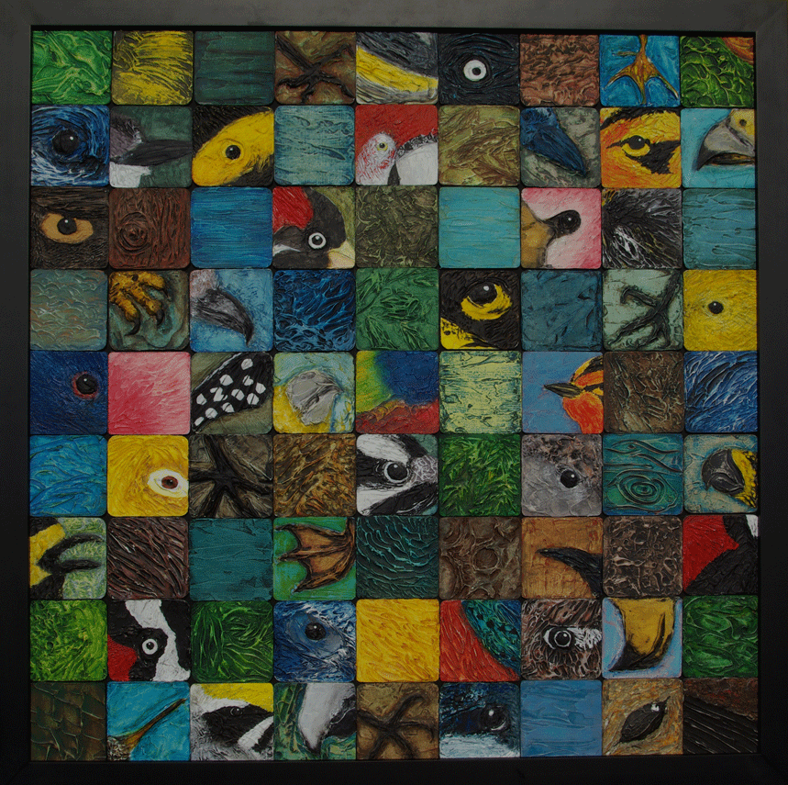
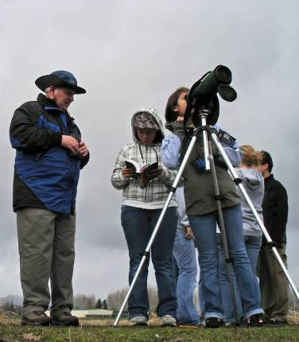
BirdSleuth: Most Wanted Birds with Phil Kahler
Tualatin Valley Academy
Hillsboro, Oregon
Open your students’ eyes to the birds all around them! The Most Wanted Birds kit includes full-color focus cards, interactive computer-based bird ID quizzes, posters, and hands-on activities. Your students will learn how to identify the birds in your schoolyard and to report their bird sightings on eBird!

Slide 2
Sessions
Title: BirdSleuth: Most Wanted Birds
Timeslot: Breakout Session 200, 11:15am-12:30pm, MONDAY, AUGUST 6
Unique ID: 224
Room Name: Lincoln A (87)
Title: Classroom Beekeeping
Timeslot: Breakout Session 300, 3:45-5pm, MONDAY, AUGUST 6
Unique ID: 353
Room Name: Ryman Studio C (24)
Title: BirdSleuth: Investigating Evidence
Timeslot: Breakout Session 400, 11:15am-12:30pm, TUESDAY, AUGUST 7
Unique ID: 422
Room Name: Lincoln C (72)
Title: BirdSleuth: Authentic Scientific Inquiry Using Free Online Wikispaces
Timeslot: Breakout Session 600, 9:45-11am, WEDNESDAY, AUGUST 8
Unique ID: 624
Room Name: Lincoln C (72)

Slide 3
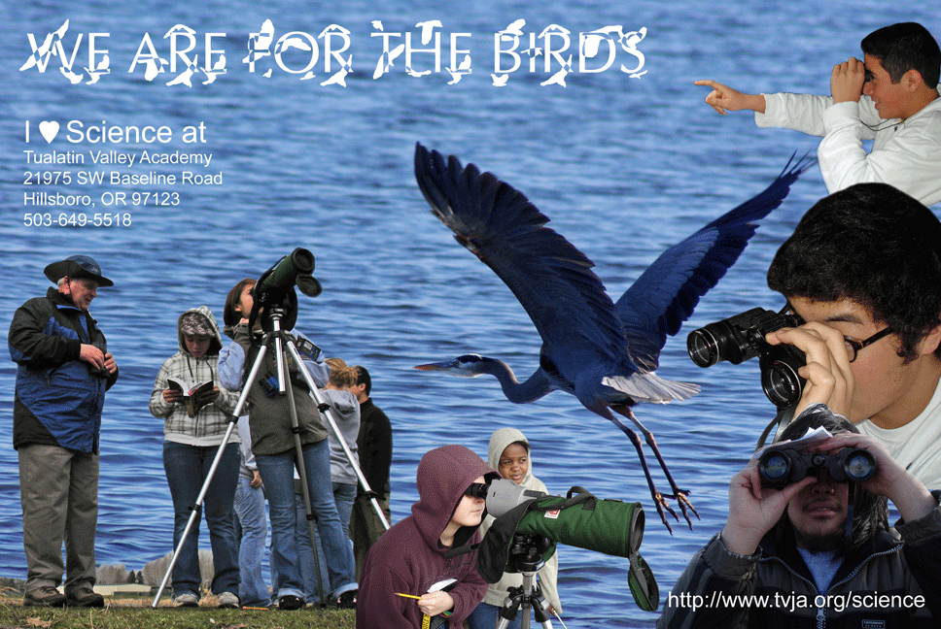

Slide 4
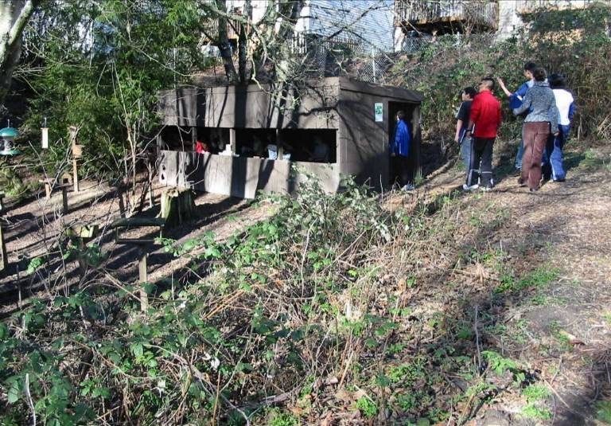
Tualatin Valley Academy’s
Bird Blind at Downy Creek

Slide 5
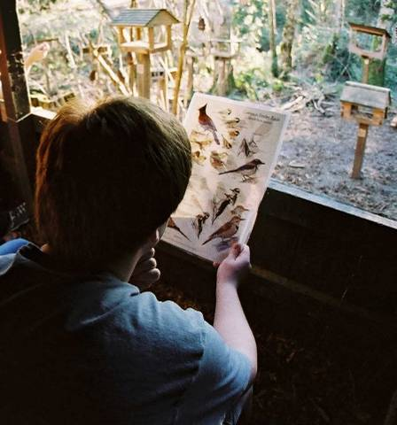
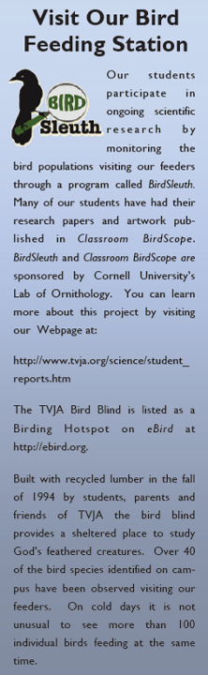

Slide 6
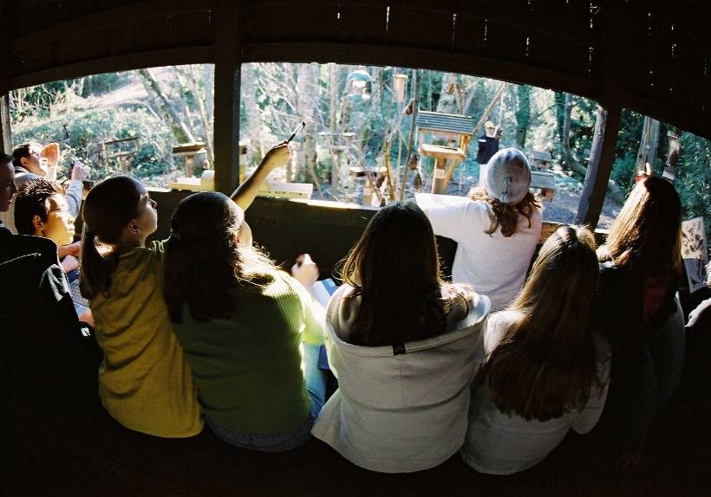
Benefits of having a feeding station at school:
Lots of inexpensive mini field trips right on campus!
  Gets the students outdoors.
  Students gain an appreciation for nature through bird watching.
  Students use the scientific method as they conduct their own research.

Slide 7
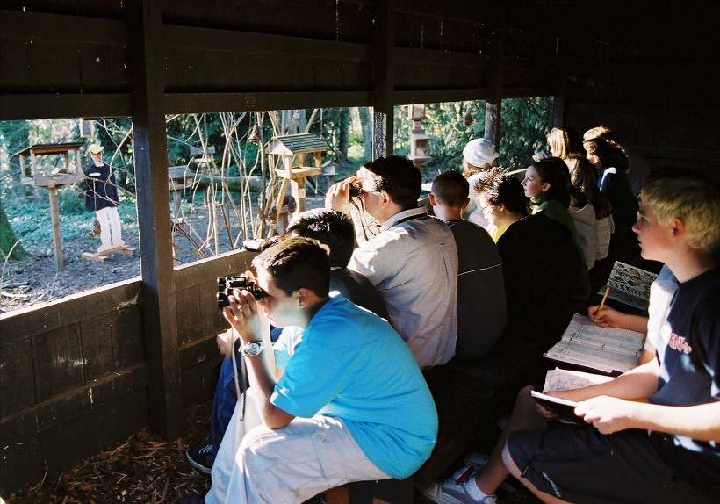
BirdSleuth Data
Share it with scientists,
and USE IT yourself!

Slide 8
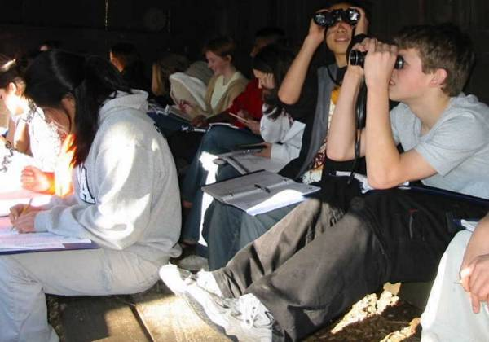
Which birds did you see?
How many of each species?

Slide 9
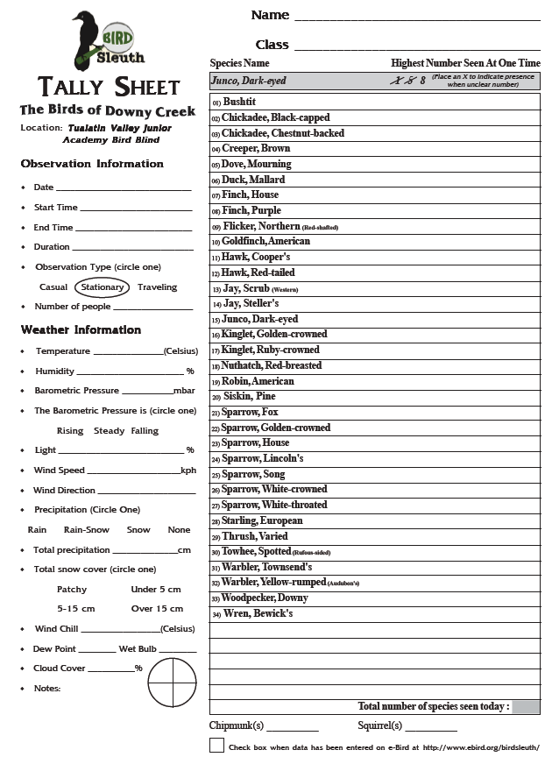
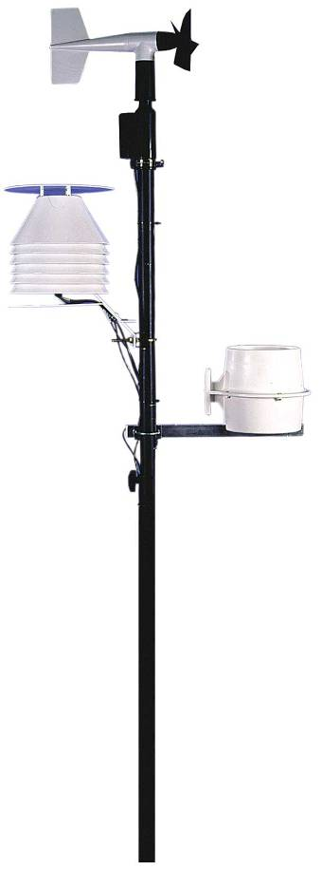
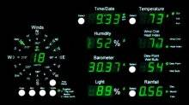
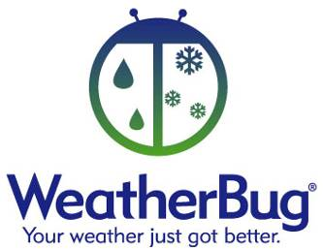

Slide 10
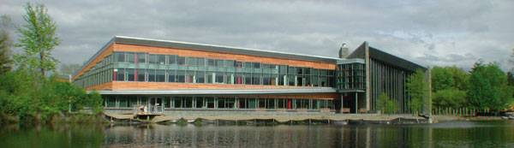
The Cornell Lab of Ornithology is a nonprofit membership institution whose mission is to interpret and conserve the earth's biological diversity through research, education, and citizen science focused on birds.
Notes:
10
The Lab is a non-profit membership institution dedicated to interpreting and conserving the earth’s biological diversity through research, education and citizen science focused on birds. By participating in this workshop, you will join the thousands of “citizen scientists” in North America who are actively engaged in scientific research and data collection with the Cornell Lab of Ornithology.

Slide 11
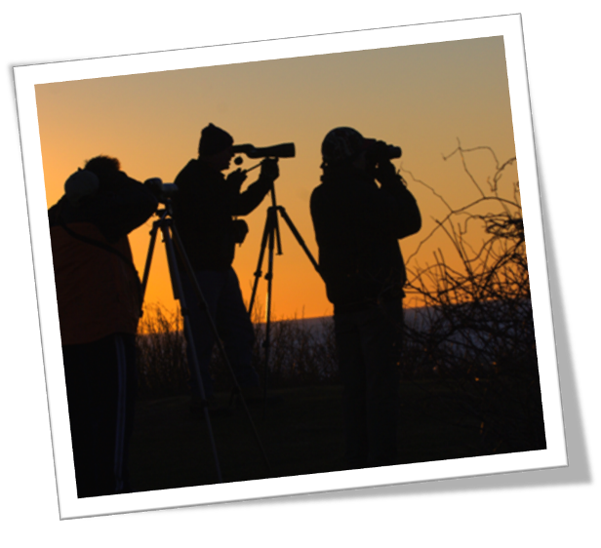
Instead of working alone, some researchers now invite volunteers to join large-scale citizen science projects.
Notes:
Instead of working alone, some researchers now invite volunteers to join large-scale citizen science projects.
11

Slide 12
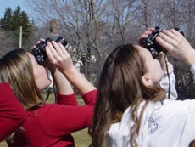
What is Citizen Science?
People throughout North America gather and submit data, allowing scientists to answer large-scale questions.
Notes:
12
12
There are millions of birdwatchers in America. Some backyard birdwatchers record data about the birds they see in their backyards, local parks, or on birdwatching trips. Imagine all that data—kinds of birds, where and when they are seen, how many are seen, habitat and weather information—scattered in notebooks all across the country!
Scientists at the Lab of Ornithology realized that the data in those people’s notebooks has amazing value! There are some interesting scientific questions that can only be answered by looking at large data sets, collected over time, over large geographic areas, but scientists can’t be everywhere. Citizen Scientists can be the eyes and ears of scientists!
Now, people all over the country collect data about the birds they see and send it to the Lab (often via the Internet), where the data becomes available to scientists and the general public.

Slide 13






Slide 14
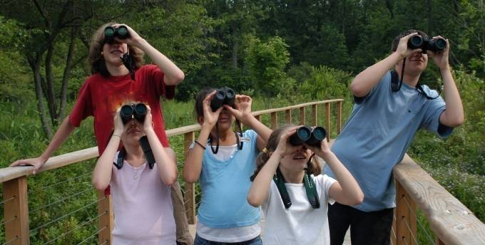
eBird
Observe any bird, anywhere, any time!
Record your observations
Send your data to the eBird website
Notes:
eBird is the specific citizen science project that BirdSleuth: Most Wanted Birds uses. eBird collects data about any bird species that people see across the continent, at any time of year. You can count in the most rural or urban environment… you don’t need to have a bird feeder but you can have one if you want… Basically, eBird just needs to know what kind of count you did, that date you collected the data, what species you saw, how many of each.

Slide 15
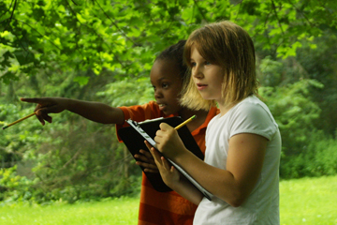
“I learned that taking them outside and letting them do bird observation was a great way to motivate them to ask questions in science.”
Notes:
15
As it turns out, observing birds and conducting citizen science provides an ideal route to student inquiry.
As students observe birds, they get curious! Questions naturally arise!

Slide 16
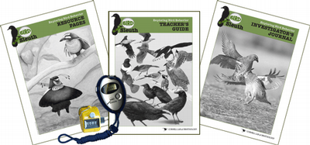
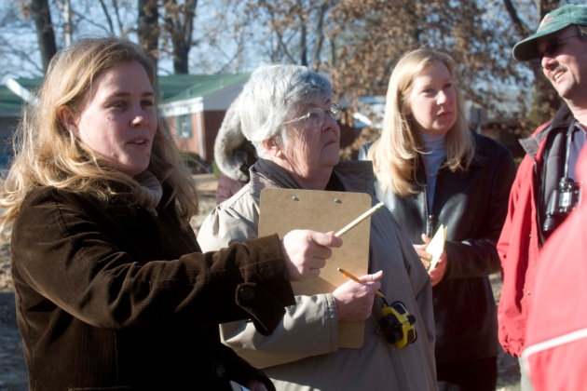
BirdSleuth Today
Curriculum Resources
Professional Development
Fee-based kits and free downloads
Online and in person
Notes:
BirdSleuth is both a curriculum and lessons, and teacher professional development program.

Slide 17
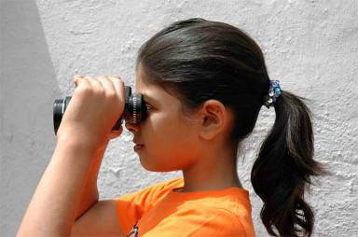
Why study birds?
Birds are everywhere and easy to study
Students are naturally captivated by bird song, flight, colors, and behaviors
A context for the scientific process— observation, discovery, conclusions
Lifelong learning and environmental awareness

Slide 18
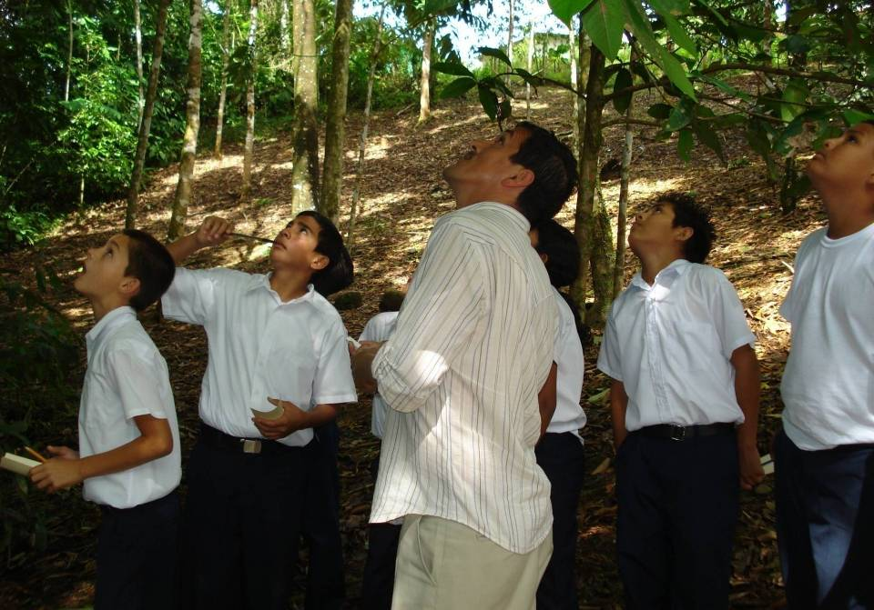
“It was wonderful to see the students learn to appreciate all these amazing birds they have in their own backyard.” -Costa Rican BirdSleuth Teacher
Notes:
School, name?

Slide 19
Novice
Beginner
Amateur
Advanced
Comfort level with birding?
Teach content on birds in your curriculum?
Minimal to none
Part of a unit
In-depth study

Slide 20
But I don’t know how to identify birds!
How am I going to help my students participate?
Notes:
You might be thinking—this is really cool! But I don’t know birds =(

Slide 21
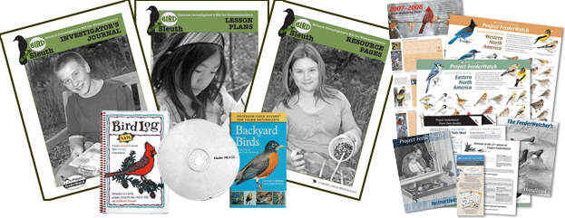
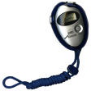
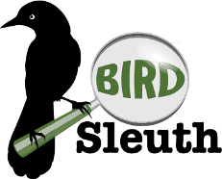
BirdSleuth helps teachers bring the power and engagement of citizen science and inquiry to their students
Notes:
Citizen science programs are low-cost or free, and easy to use. But some teachers have asked for more support and resources to help them, so educators at the Cornell Lab developed BirdSleuth with support from the National Science Foundation.

Slide 22


Science Education Standards
(National Research Council)
Notes:
Americans agree that our students urgently need better science education. The Standards offers a coherent vision of what it means to be scientifically literate, describing what all students should understand and be able to do in science. The volume reflects the principles that learning science is an inquiry-based process, that science in schools should reflect the intellectual traditions of contemporary science, and that all Americans have a role in science education reform. Standards are not a curriculum. They are not a set of lesson plans. They are goals for achievement that are appropriate for all members of the science education community.

Slide 23
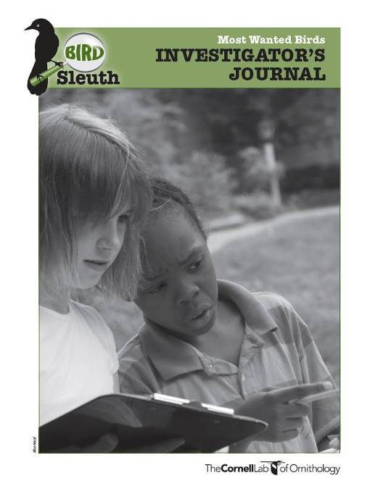
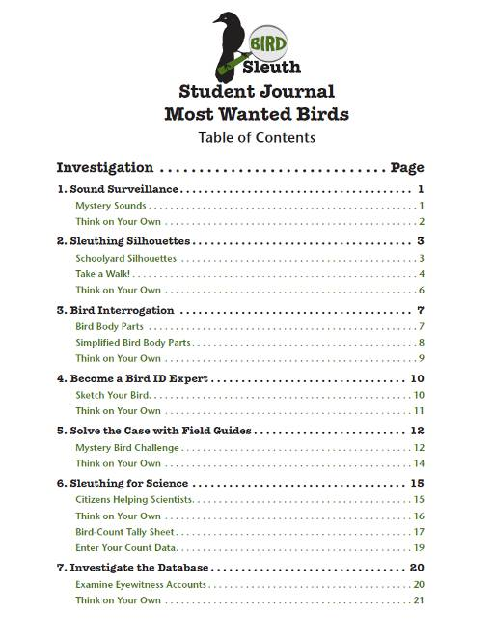

Slide 24
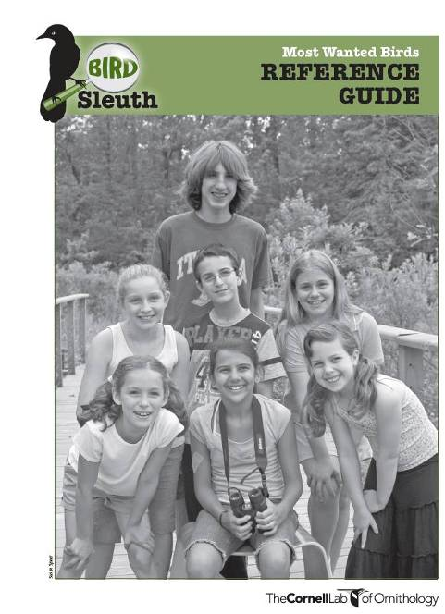
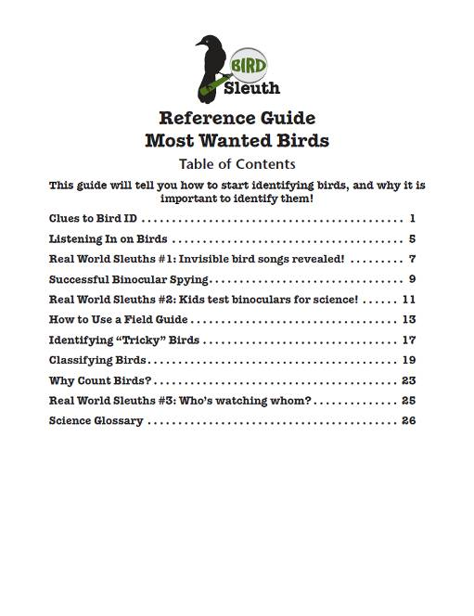

Slide 25
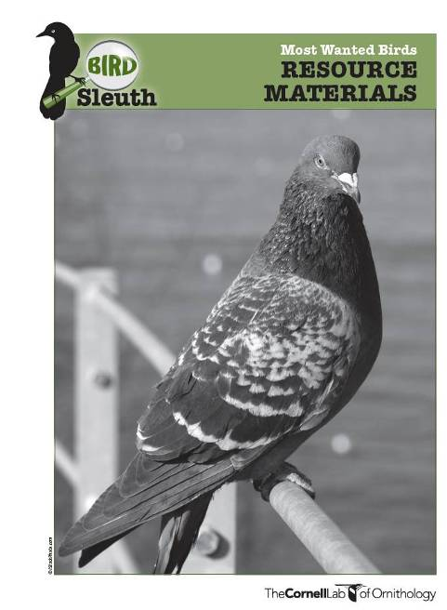
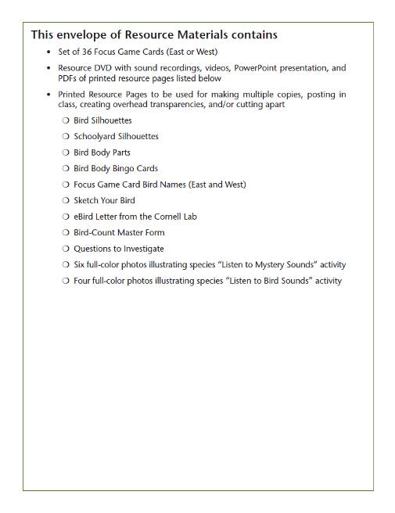
The DVD is really cool!

Slide 26
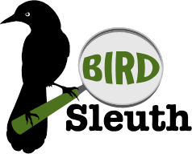
Most Wanted Birds Lessons
Sound Surveillance
Sleuthing Silhouettes
Bird Interrogation
Become a Bird ID Expert
Solve the Case with Field Guides
Sleuthing for Science
Investigate the Database
(Become an eBird Data Sleuth)
Notes:
If you are participating in eBird, consider getting the BirdSleuth: Most Wanted Birds curriculum. Will help with bird ID… discount forms in your packets—totally optional… regardless, here are some ideas and advice…

Slide 27
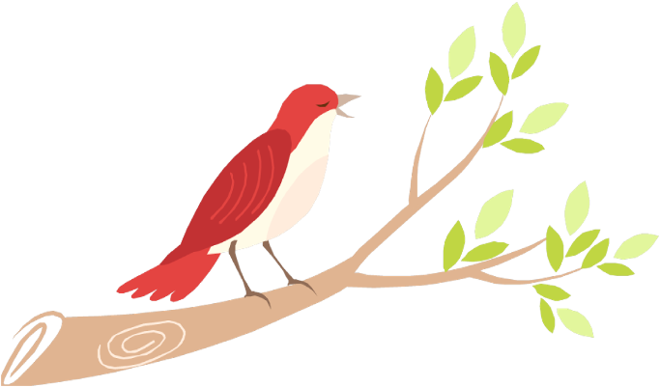
1. Sound Surveillance
Many birders learn to identify birds by sound…
Notes:
You can play the 3 common birds here!

Slide 28
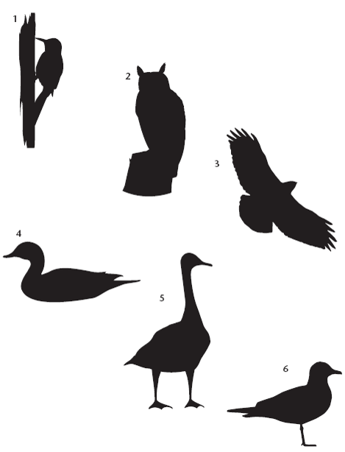
2. Sleuthing Silhouettes:
Use shape to tell birds apart.
Notes:
CONSIDER PLAYING THE FIRST “INSIDE BIRDING” MOVIE (~10 MINUTES)
Really, being successful with eBird begins with knowing what species of birds you see.
How many of you would consider yourself only a beginning (novice) birder?…
Even those of you who said yes… can you identify any of these bird groups? (1. woodpecker, 2. owl, 3. hawk [some might say vulture or “bird of prey”], 4. duck [or other water bird], 5. goose, 6. gull [some may say plover, shorebird, etc.])
Even beginning birders or young kids can begin putting birds into groups, and that’s truly one of the most critical steps.
What clues did you use to put the birds into groups? [things like general shape, shape of body parts, they way it is sitting, etc.] These very basic clues are often the first things even experienced birders look at.
Activity Idea: Begin a list on the board of Clues To Bird ID. Add to it in subsequent slides.

Slide 29
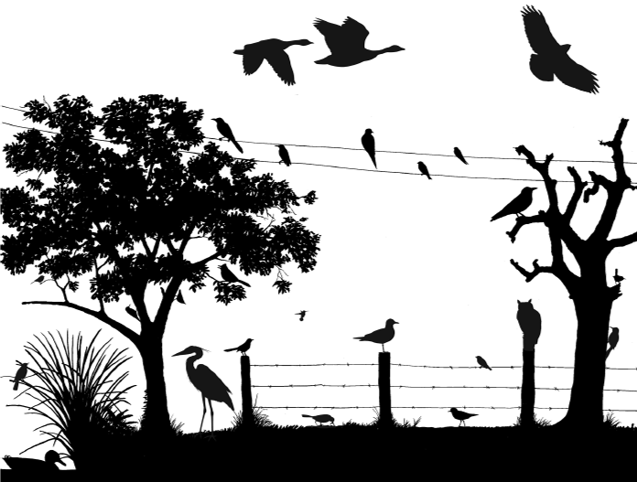
What species can you recognize?
Notes:
Now, we’ve added even more “clues”- so you might be able to go further than just identifying these birds to group. Can you name any species?
How did you know those species? What other clues can you use to tell these birds apart? [size, shape, location, habitat, behavior– examples wren holding up tail, nuthatch clinging to the tree upside-down]
Even with small children, this diagram can be used like a seek-and-find- it is useful for encouraging them to look all around when they go outside to observe birds. Where are birds found here? [on trees, in branches, in the sky, on the ground, in water, on power lines, on fence posts and wires, etc.]

Slide 30
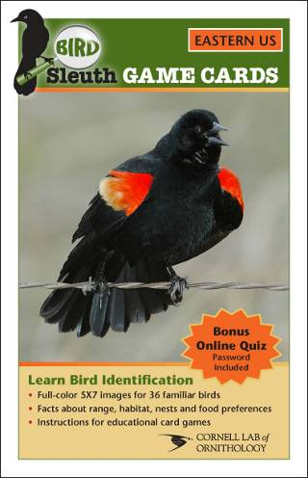
3. Bird Interrogation Who’s My Focus Bird?
Notes:
BirdSleuth offers you many resources to help you mentor kids in identifying birds. For example, there are a set of 36 “focus card birds” in each BirdSleuth: Most Wanted Birds kit. Each student becomes an expert in one of the birds– most students like learning about “their bird” and they also serve as the class expert in that bird’s identification if they see the bird outside.
Here, the student is drawing the Mallard and labeling the bird’s field marks. He’ll be the expert on the Mallard throughout the BirdSleuth lessons.

Slide 31

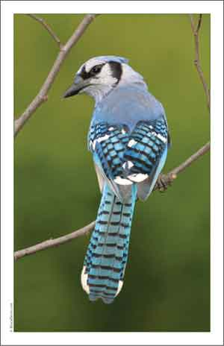
3. Bird Interrogation
What to Look For
Size
Posture
Shape
Color
Field Marks
Location
Habitat
Sounds

Slide 32
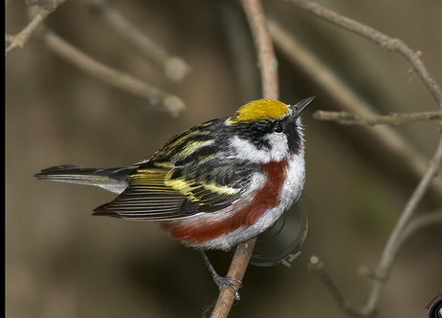
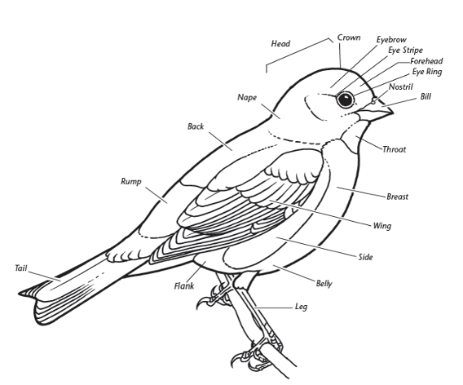
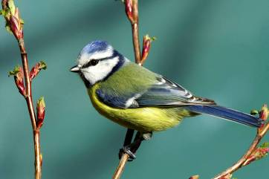
3. Bird Interrogation
“Field Marks”
Notes:
YOU COULD DO THIS ACTIVITY BUT IT CAN TAKE AWHILE (20 MINUTES) AND MAY NOT WORK UNLESS THERE ARE FEWER THAN ABOUT 25 PEOPLE.

Slide 33
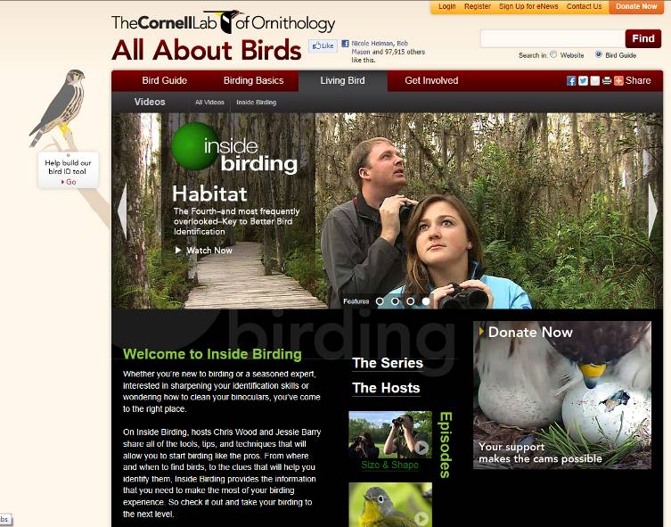
Inside Birding Videos

Slide 34
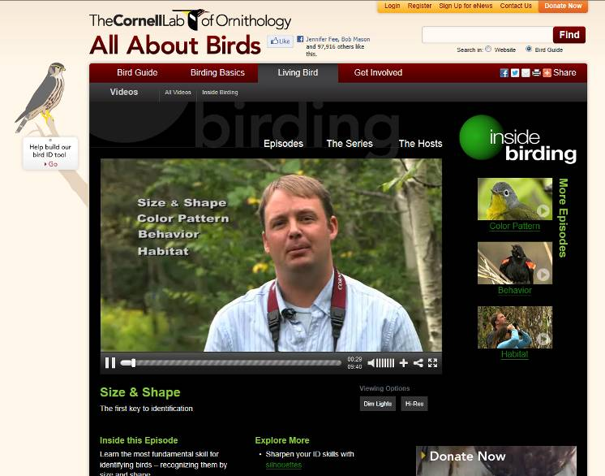
Inside Birding Videos
Keys to Bird Identification:
(The 4 Online Episodes are included on the DVD!)
  Size & Shape
  Color Pattern
  Behavior
  Habitat

Slide 35

Inside Birding Videos
Size & Shape
This video available at http://www.allaboutbirds.org/page.aspx?pid=1266 or
http://www.youtube.com/watch?v=ridajl8uic0
Notes:
This video is included on the “Most Wanted Birds” DVD that comes with the curriculum package.
The video is also available to watch online at http://www.allaboutbirds.org/page.aspx?pid=1266 or
http://www.youtube.com/watch?v=ridajl8uic0

Slide 36
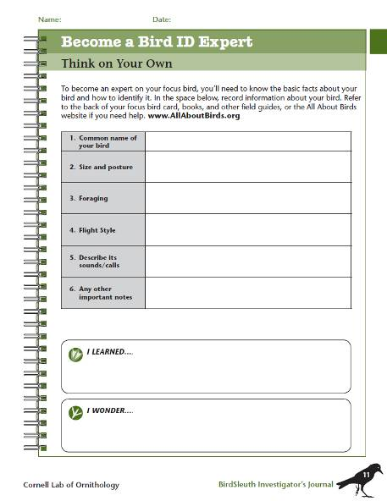
4. Become a Bird ID Expert
A page from the Most Wanted Birds Investigator’s Journal

Slide 37
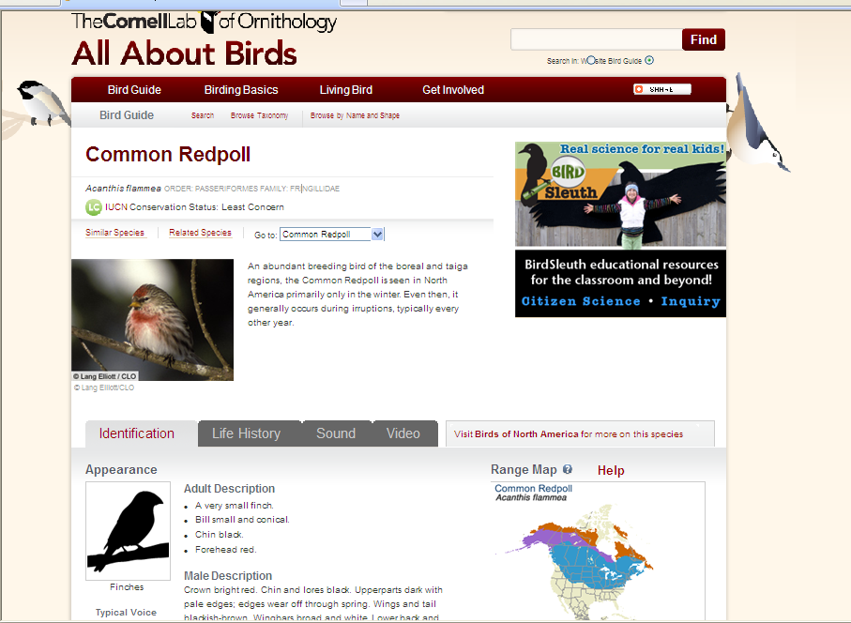
Notes:
All About Birds is a really useful site to listen to, watch videos of, and learn to identify birds. Especially check out the “Inside Birding” video series which helps beginning birders learn how to “go birding.”
Consider introducing a “bird of the day” common to your area.

Slide 38
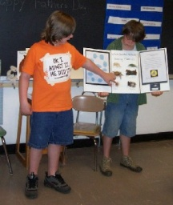
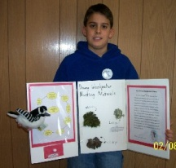
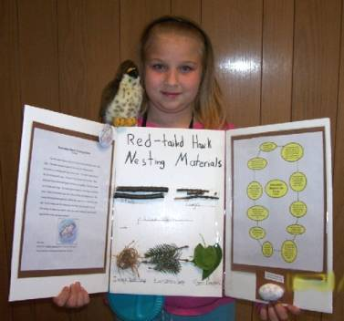
Notes:
Some teachers have their students focus on being an expert in one bird.

Slide 39
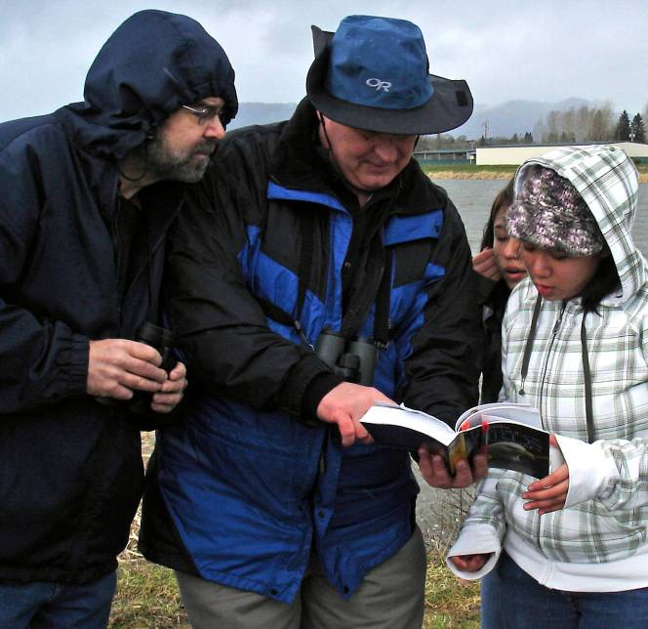
5. Solve the Case with
Field Guides

Slide 40
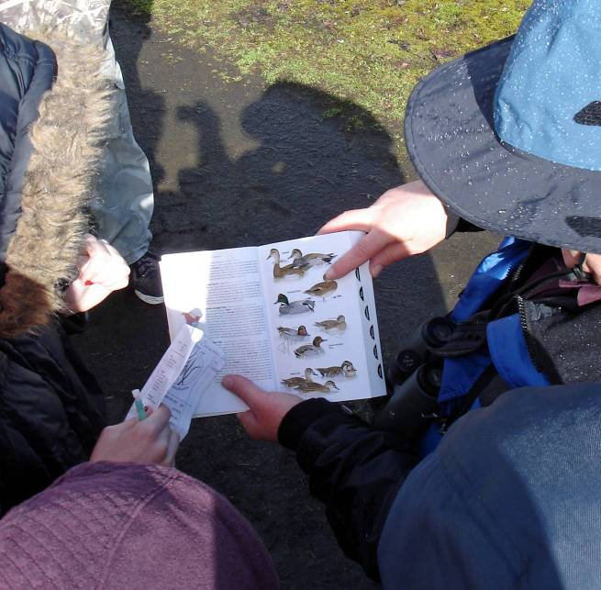
5. Solve the Case with
Field Guides

Slide 41
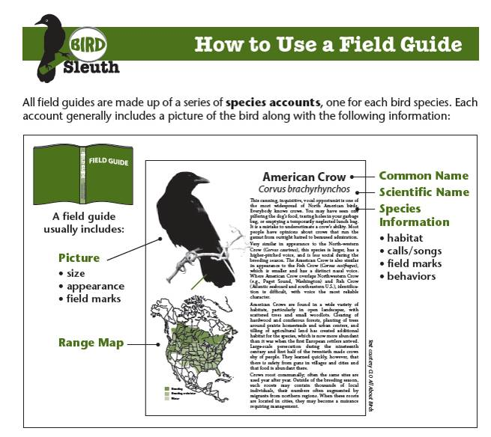
A page from the Most Wanted Birds Reference Guide

Slide 42





5. Solve the Case with
Field Guides
Available at:
  Second Hand Stores / Goodwill
  Bookstores Everywhere
  Amazon

Slide 43

5. Solve the Case with
Field Guides

Slide 44

Registering for eBird is Easy!
Go to www.ebird.org
6. Sleuthing for Science
click on “Register as a new user”
Notes:
Part 2: Registering for eBird. Consider registering individuals if you have computer access, or demo registration.
In the beginning, kids won’t register- you will.
You can provide kids with your username and password if you want.
You can work with individual students who are interested to get them registered for entering home checklists.

Slide 45

6. Sleuthing for Science eBird
Any bird!
Anywhere!
Any time!
Notes:
45
eBird is the specific citizen science project that BirdSleuth: Most Wanted Birds uses. eBird collects data about any bird species that people see across the continent, at any time of year. You can count in the most rural or urban environment… you don’t need to have a bird feeder but you can have one if you want… Basically, eBird just needs to know what kind of count you did, that date you collected the data, what species you saw, how many of each.

Slide 46

6. Sleuthing for Science
Do a sample count
Notes:
This can be done indoors with focus cards! I can explain!

Slide 47

Which birds did you see?
How many of each species?
Notes:
47
Entering our observations into eBird really does make a difference. Now people around the country are using our data! And each checklist we’ve submitted helps add to the understanding of birds. The scientists at the Cornell Lab of Ornithology appreciate our participation.

Slide 48


Recording Results

Slide 50

Where were you?

Slide 51

How did you count birds?

Slide 52

What birds did you count?

Slide 53

Enter our data!

Slide 54


Slide 55

Life List

Slide 56

Life List

Slide 57

7. Investigating the Database

Slide 58

Exploring eBird Data is easy!
Go to www.ebird.org/birdsleuth
click on “View and Explore Data”
Notes:
58
When we submitted data, we went to the “Submit Observations” tab. But when you want to look at data, you should go to the “View and Explore Data” tab next to it.
(Note: You can demo the following slides, then have teachers go live onto eBird to explore their own questions!)

Slide 59


What can we learn about
Mourning Doves?
Notes:
59
Let’s use the “A particular species” option to find out about the Mourning Dove as an example.

Slide 60

FREQUENCY CHART
RANGE MAP
Notes:
60
After you type in the bird’s name and select it, you’ll be taken to a map page that looks like this. This page has two parts. At the top is a graph we’ll call a “frequency chart.” The range map is on the bottom.
ASK:
I’ll explain this more in a minute, but what do you notice about this screen right now?
From the map, kids might notice that there is green all over the United States, meaning that the Mourning Dove is common throughout the country (though fewer are seen in the northwestern United States).
From the frequency chart, they might be able to notice that the Mourning Dove is pretty common throughout the year.
[Note: Accept all answers for now… we’ll get more specific in a few slides!]

Slide 61

Map Key
• Mourning Doves were observed
x A checklist was submitted, but no Mourning Doves were reported
White Areas:
No eBird Report
(New York only)
Notes:
61
There are two symbols on the map that we need to know:
Green dots= Mourning Doves have been observed.
Gray X= Places where an eBirder has sent in a checklist, but did not report seeing any Mourning Doves.
There haven’t been any checklists submitted in the white areas, so we can’t be sure whether Mourning Doves would be seen there. Notice that the dots and X’s only show up in New York, since that is the state we selected. We can’t tell anything from this map about the nearby states, like Vermont and Pennsylvania.
ASK:
Where are Mourning Doves seen most?
Many checklists in the western (left) half of the state reported Mourning Doves. Also, on Long Island and along the eastern edge of the state.
Where are Mourning Doves less likely to be seen?
In the northern/central part of the state.
Note that we can not say whether there are Morning Doves in the parts of the state that are white. We do not have data from those areas, so we can’t come to a conclusion. We need more eBirders in those areas!

Slide 62

Let’s look at these options:
FREQUENCY
AVERAGE COUNT
MAP (done)
Notes:
62
We’ve already explored eBird maps and frequency charts and discovered some of the things we can learn from them. Now let’s look at two of the other types of graphs available for summarizing eBird data: frequency graphs and average count graphs. Taken together, these graphs can tell us a lot about what’s going on with a particular species.

Slide 63

7. Investigating the Database
Example data output from eBird, indicating that 332 bird species were observed in Wisconsin in 2011. The bar charts show that Canada Geese were seen year-round whereas several other goose species were reported in the state during limited times of year.

Slide 64

7. Investigating the Database
Comparison of sightings recorded in eBird of
Broad-winged and Rough-legged Hawks in Wisconsin.

Slide 65

7. Investigating the Database
Frequency graphs for Broad-winged and Rough-legged Hawks in Wisconsin show opposite patterns for these two species.

Slide 66

7. Investigating the Database
Graphs of Average Count show large spring and fall peaks for the Broad-winged Hawk in Wisconsin, corresponding with migrating flocks heading north in late April and returning south in mid-September. Compare these patterns with the relatively moderate seasonal trends for the Rough-legged Hawk.

Slide 67


7. Investigating the Database
Range maps for the Broad-winged Hawk (left) and Rough-legged Hawk (right) reveal differences in which parts of their life cycles are spent in the lower 48 states. Image source: http://www.allaboutbirds.org.

Slide 68

You Can Be a Citizen Scientist
Notes:
This video is included on the “Most Wanted Birds” DVD that comes with the curriculum package.
Video available online at http://www.youtube.com/watch?v=d5OPTvrHh0U

Slide 69

Student Counts Really Matter!
BirdSleuth brings the power and engagement of citizen science to students!
Notes:
69
69
As you can see, if Cornell doesn’t have several observations from many people, the data isn’t as useful or revealing.
So keep the counts coming!
And use eBird to view and explore data!
Activity (next slide): Go online to view and explore your own questions!

Slide 70



Binoculars

Slide 71

A page from the Most Wanted Birds Reference Guide

Slide 72

Binoculars
Almost everyone has one eye that is stronger than the other. If you are having trouble focusing you can adjust this lens by turning to the + or -.
    ocular
    objective
    diopter
    frenzel
Notes:
C) Diopter

Slide 73

Binoculars
If you can’t focus on birds even after following the instructions you should
    Check to see if the lenses need cleaning
    Buy new binoculars
    Wash the binoculars in boiling water
    Hold your breath while focusing
Notes:
A) Check to see if the lenses need cleaning.

Slide 74
Binoculars
True or False
Always carry your binoculars by wearing the strap around your neck.
Notes:
True

Slide 75

Feeders & Field Trips
Students who are familiar with watching birds at feeders may be unaware that many species will never come to a feeder. In the winter of 2011-2012, for example, FeederWatchers in Pennsylvania reported 95 species compared with 275 in eBird.

Slide 76

John Gatchet
7th & 8th Grade Fernhill Wetlands Bird Watching Trip

Slide 77

7th & 8th Grade Fernhill Wetlands Bird Watching Trip

Slide 78

7th & 8th Grade Fernhill Wetlands Bird Watching Trip

Slide 79

Fernhill Wetlands

Slide 80

Fernhill Wetlands

Slide 81

Fernhill Wetlands

Slide 82

Fernhill Wetlands

Slide 83

Fernhill Wetlands

Slide 84

Fernhill Wetlands

Slide 85

Fernhill Wetlands

Slide 86

True or False:
Bird-Watching is a hobby with an estimated 80 million people and is considered the number-one spectator sport in North America.
Notes:
True

Slide 87


Slide 88


Slide 89


Slide 90


Slide 91



There's an App for That!

Slide 92

Fernhill Wetlands

Slide 93



Slide 94
Connecting to Birds through Art
“I think the Orange-breasted Falcon… seems like kind of a leader, or the boss of birds. It was hard trying to convey the feeling of this bird.”
“When I found out scientists were studying these birds, I wondered what they did all the way over in New York. I would love to go and study birds with them.”
“Now I care about birds and actually notice them.”

Slide 95




Learn in an interdisciplinary way: science, math, technology, reading, social studies, and art through birds
Students like Su sketch their species from photos.
After layering a gel that creates depth, she begins painting.
Su said…
“I was so excited about this. I wanted to know what researchers at the Cornell Lab already knew about the bird, and I came to know it well.”
As she continues her painting in art class, she studies the species, and participates in BirdSleuth studies in science class.

Slide 96



Slide 97



Slide 98




BirdSleuth: Investigating Evidence
BirdSleuth: Investigating Evidence
Breakout Session 400, 11:15am-12:30pm, TUESDAY, AUGUST 7
Room: Lincoln C (72)
Find out how you can download this curriculum for FREE!

Slide 99

Downy Creek Bird Blind
TVA’s Citizen Science Central!

Slide 100
Ongoing Bird Population Research at TVA

Slide 101
Ongoing Bird Population Research at TVA

Slide 102




Slide 103

TVA Student Research Reports Get Published!

Slide 104



Wiki Connection
TVA kids are partnering with kids in Florida on research projects and peer review!
BirdSleuth: Authentic Scientific Inquiry Using Free Online Wikispaces
Breakout Session 600, 9:45-11am, WEDNESDAY, AUGUST 8
Room: Lincoln C
Notes:
104

Slide 105

Investigating Birds: Supporting Student Inquiry
A BirdSleuth Course for Educators
Notes:
105

Slide 106

Investigating Birds: Supporting Student Inquiry
Audience: Educators interested in engaging students in BirdSleuth investigations
Goal: Help educators gain science process skills and the confidence needed to facilitate student research
Format: Five week, instructor-led, asynchronous summer course
Notes:
106

Slide 107
Sessions
Title: BirdSleuth: Most Wanted Birds
Timeslot: Breakout Session 200, 11:15am-12:30pm, MONDAY, AUGUST 6
Unique ID: 224
Room Name: Lincoln A (87)
Title: Classroom Beekeeping
Timeslot: Breakout Session 300, 3:45-5pm, MONDAY, AUGUST 6
Unique ID: 353
Room Name: Ryman Studio C (24)
Title: BirdSleuth: Investigating Evidence
Timeslot: Breakout Session 400, 11:15am-12:30pm, TUESDAY, AUGUST 7
Unique ID: 422
Room Name: Lincoln C (72)
Title: BirdSleuth: Authentic Scientific Inquiry Using Free Online Wikispaces
Timeslot: Breakout Session 600, 9:45-11am, WEDNESDAY, AUGUST 8
Unique ID: 624
Room Name: Lincoln C (72)

Slide 108

BirdSleuth: Most Wanted Birds
Phil Kahler philk@tvja.org
Tualatin Valley Academy
21975 SW Baseline Road
Hillsboro, Oregon 97123
Web Addresses
http://www.birdsleuth.net
http://ebird.org
http://www.allaboutbirds.org
http://tvja.org/science/birds.htm
http://tvja.org/science/student_reports.htm
http://tvja.org/science/bird_blind.htm
http://tvja.org/science/student_bird_art.htm

